Slide 1

Living Well: Lessons from the Blue Zones
Jessica Naber, RN, PhD

Slide 2
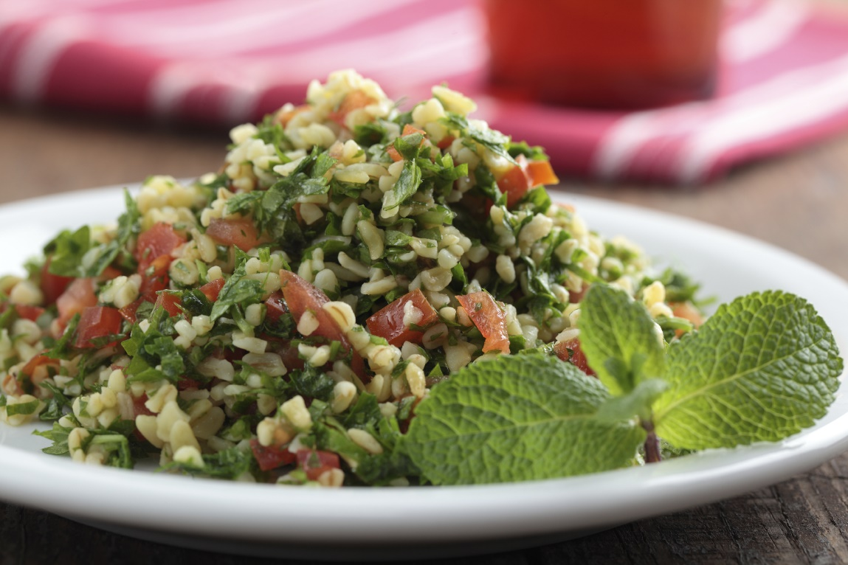
Today’s Blue Zone Menu
*Tabouli Salad
*Caponata with Lentils in Warm Pita
*Chickpea Lentil Soup
*Sweet Potato Chili
*Peanut Butter and Oatmeal Energy Balls

Slide 3

A Theory: Blue zones
*In 2004, National Geographic teamed up with longevity researchers to identify pockets around the world where people live measurably longer lives.
*In these “Blue Zones”, people reach age 100 at a rate 10 times greater than the United States.
*There are five identified Blue Zones.
*Researchers have been studying these zones’ residents to identify lifestyle characteristics that explain the longevity.
*Lifestyles of all Blue Zone residents share specific characteristics.

Slide 4

Blue zones
*Ikaria, Greece: People on this tiny Aegean island live 8 years longer than Americans; 20% less cancer, half the rate of heart disease, no dementia
*Loma Linda, California: Adventist community where residents outlive other Americans by a decade
*Sardinia, Italy: Mediterranean island with mountain villages; more male centenarians than anywhere on the globe
*Okinawa, Japan: South Pacific island nation with the world’s longest-living females
*Nicoya, Costa Rica: Central American island region where people are twice as likely as Americans to live to 90 years old

Slide 5
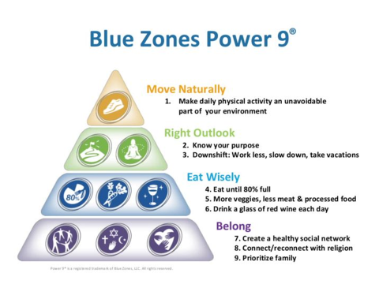

Slide 6

Blue zones project
*The Blue Zones Project is a systems approach in which citizens, schools, employers, restaurants, grocery stores, and community leaders collaborate on policies and programs that move the community towards better health and well-being.
*Goal: Increase in well-being and a decrease in health-care costs

Slide 7
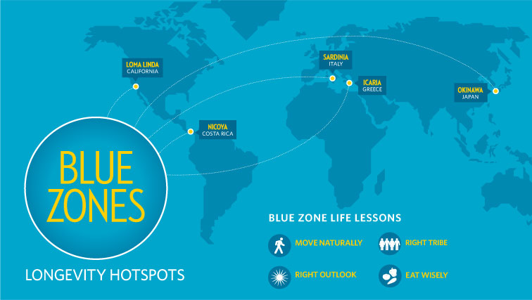
Study abroad blue zone experience in Sardinia, Italy: Summer, 2017
*Purpose: to study the Sardinian Blue Zone and return with information related to the use of the Power 9 to share with community and patients
  Observing people
  Meeting with experts
  Immersion into culture
*Goal: to implement elements learned and to develop projects related to and/or enlisting assistance of Blue Zones Project

Slide 8
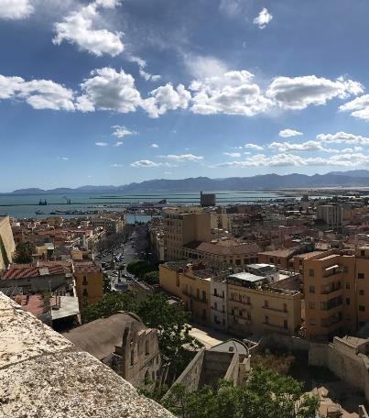
Sardinia, Italy: Blue Zone
Sardinia
Capital City: Cagliari
Total population: 1,658,138 (2015)
Area: 9,301 square miles
Second largest Italian island behind Sicily
Climate: subtropical
Geography: mountainous, grasslands, salt-marshes, cliffs and beaches on the shore line

Slide 9
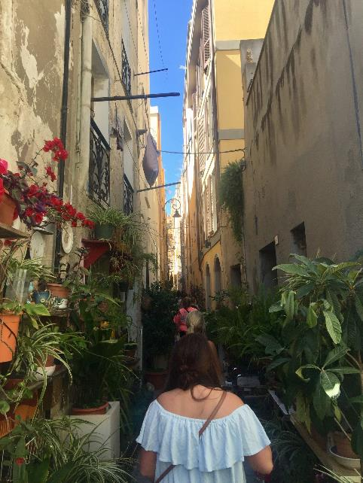
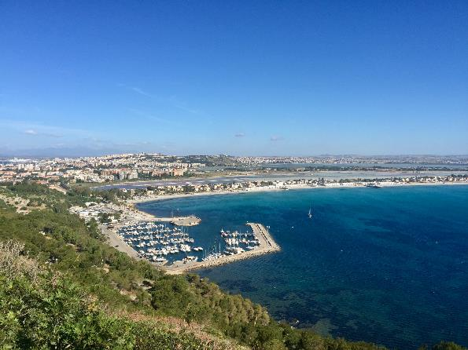
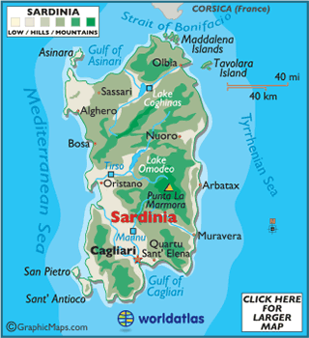
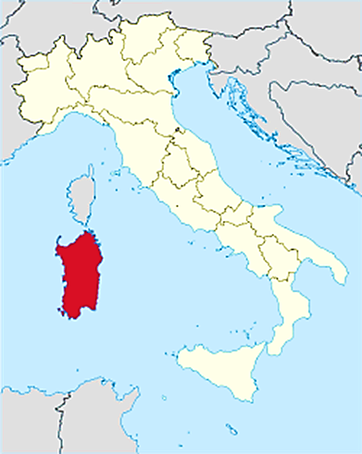
Skldl’ksdasdf;sdjf;lksdjf;lsdjl;f’
Cagliari

Slide 10
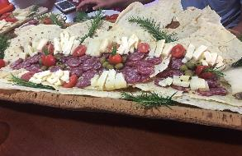
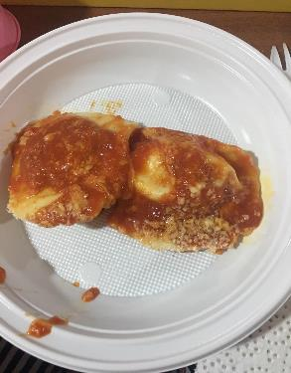
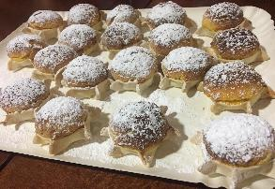
Cooking Class
Antipasti: Salami, pecorino cheese, flatbread, wine
Main Dish: Ravioli with ricotta and lemon zest covered with tomato sauce
Dessert: Bontade Pardule –Baked ricotta cheese, lemon zest, and orange zest with pastry shell covered with powdered sugar
Notes:
They gave us a chance to pinch the deserts
Insert more pictures of cooking class

Slide 11
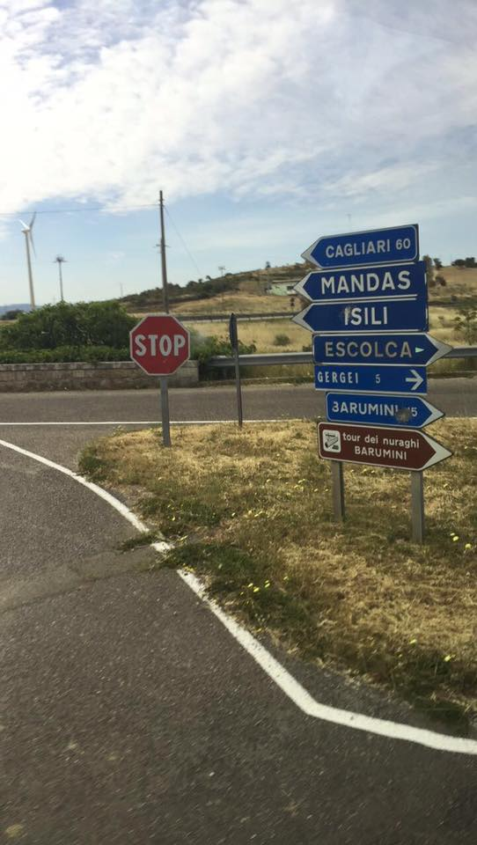
Escolca/Gergeth Centenarians
Escolca/Gergei Region:
Visit with Centenarians
Learned about: diet, spiritual beliefs, and lifestyle
  Plant-based diet that is locally grown
  Meat is a rarity; about 5x a month
  Each centenarian discussed family, religion, and a purpose in life
  Walking is the main mode of transportation – move naturally!
  Garden vegetables are preserved with vinegar to last throughout the winter
  Small portions of red wine daily around 5 o’clock
616 inhabitants
Modest living
Toured the city and a community garden and met with Blue Zone expert
Visited with locals
Community garden

Slide 12
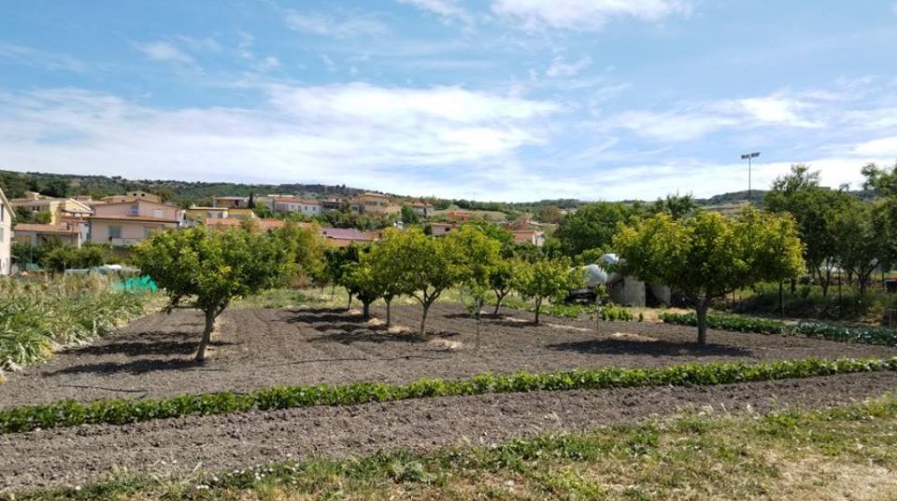
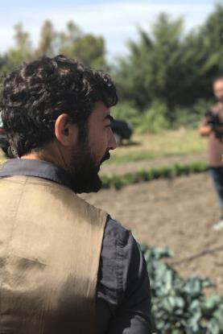
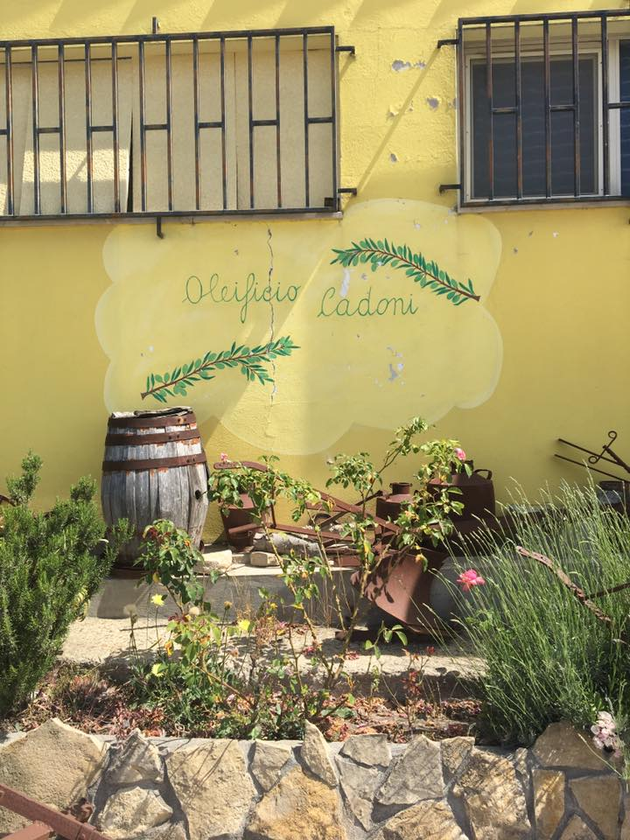
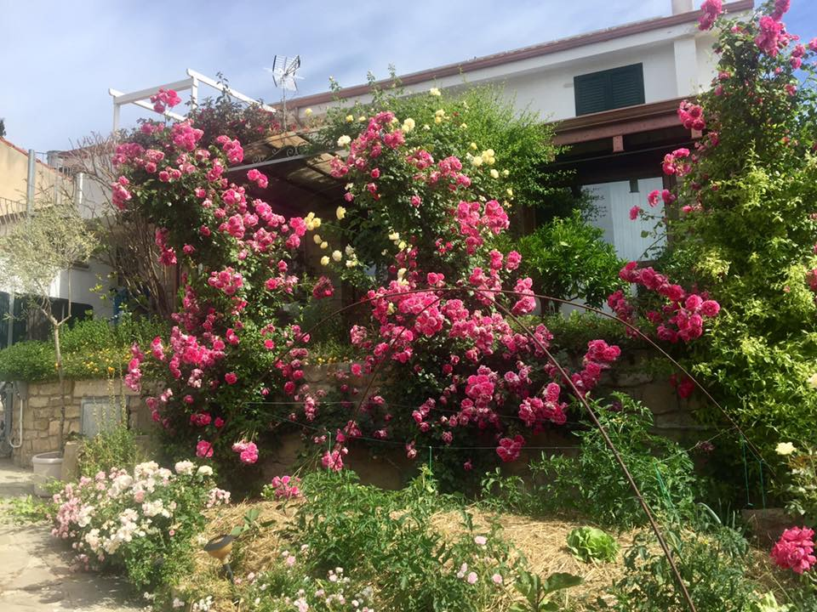
jf;sdkjfl;sdkjfl;ksdjf;wheoewjflsn;ksdforjlrjmsdl;fmsd’lkfjoie’rjeworjd’sl

Slide 13
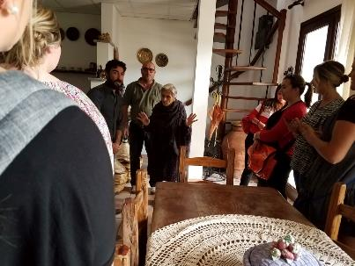
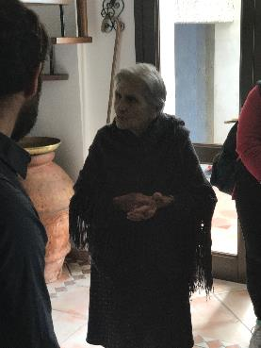
Centenarians
CENTENARIANS
99-year-old near centenarian who lives with family and uses the spiral staircase daily
Notes:
Notice posture

Slide 14
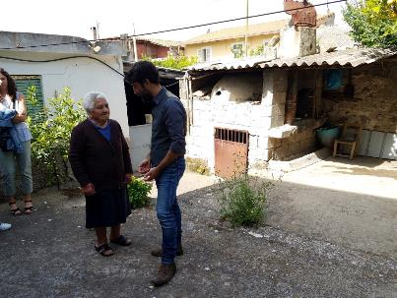
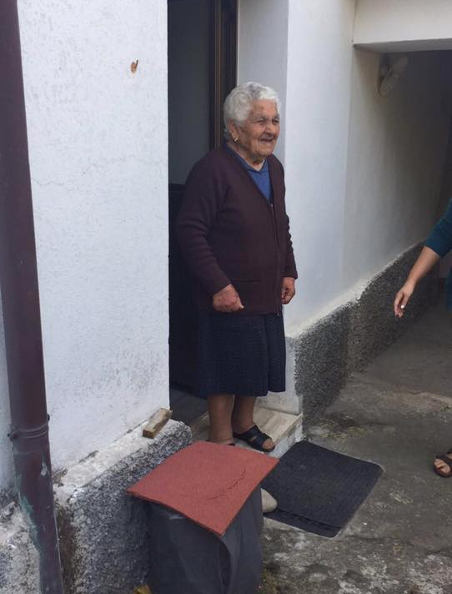
Centenarians
97-year-old who lives by herself and tends to the household
Notes:
Although both are women, Sardinia is known for highest # of male centenarians

Slide 15
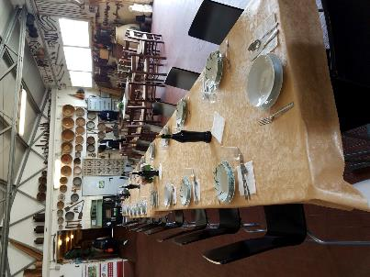
“Sa Mola”Olio Extra Vergine di Oliva
“Sa Mola”Olio Extra Vergine di Oliva
Established in 1913
Owned by the Cadoni Family
“Sa Mola” means granite millstone
Served traditional meal consisting of tea/cookies, starter (salami, cheese, bread, olives), a salsa type dish, fava beans, garbanzo beans, wild boar, small desserts, and local cannanou wine
Notes:
Time to socialize

Slide 16
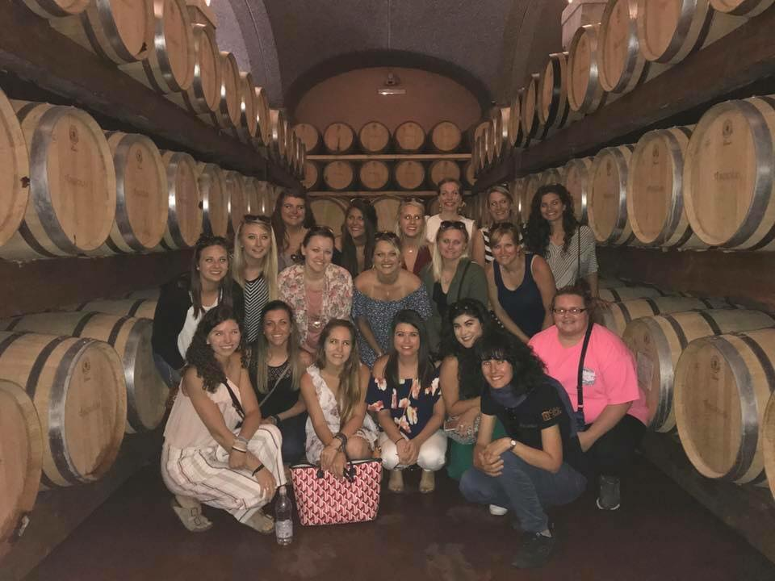
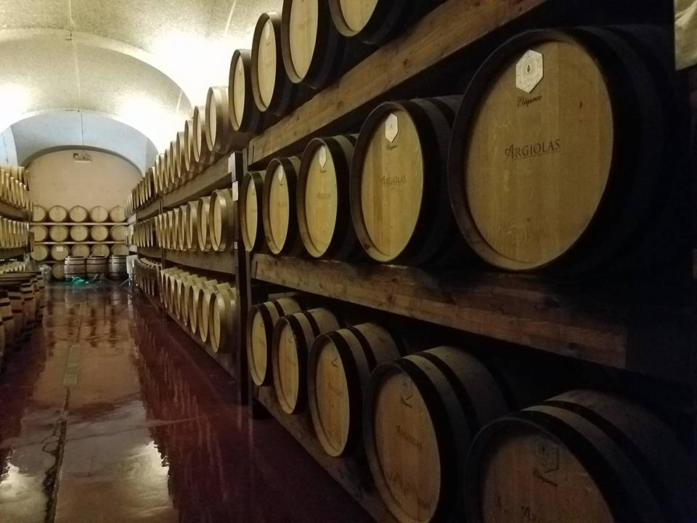
Argiolas: Sardinian Winery
Argiolas: Sardinian Winery
Learned about the process of winemaking
Local centenarian pictures adorned the walls of the winery
Blue Zone Fact:
  Polyphenols in the skins of red grapes cause the “artery scrubbing” effect
Notes:
Cannanou wine

Slide 17

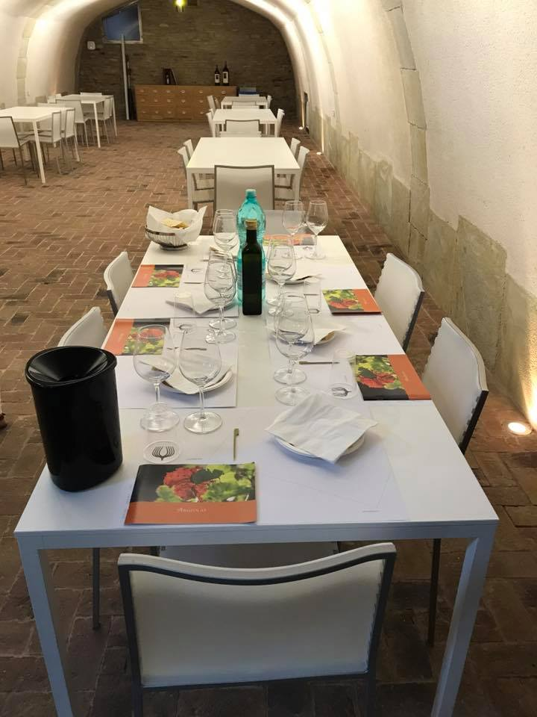
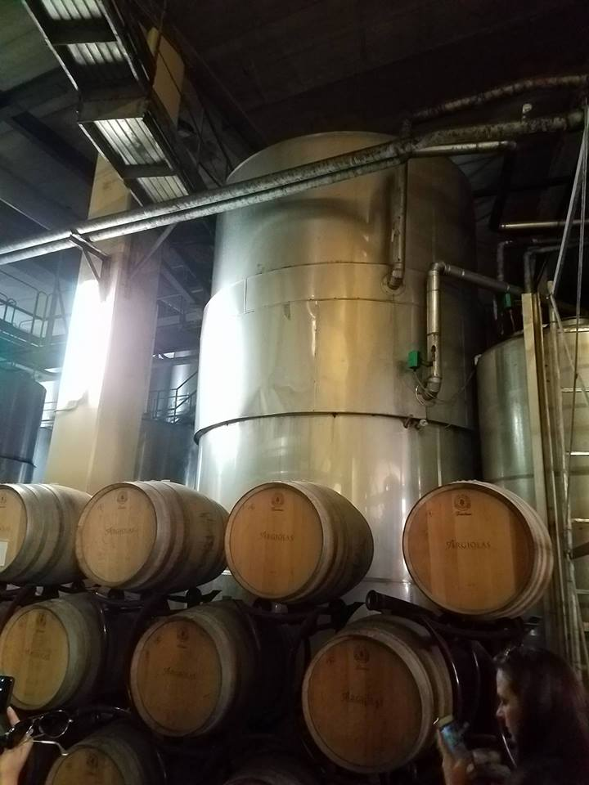
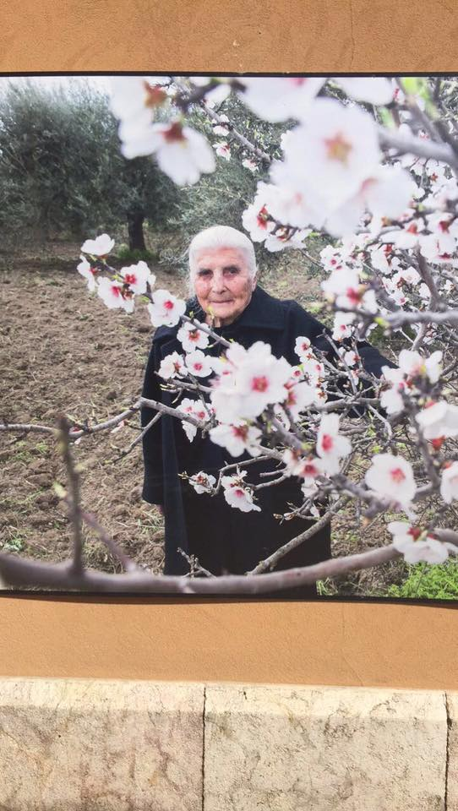
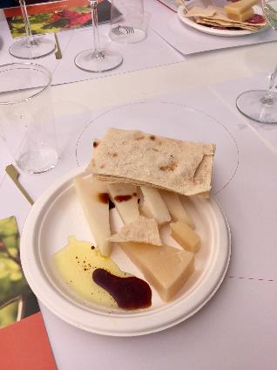

Slide 18
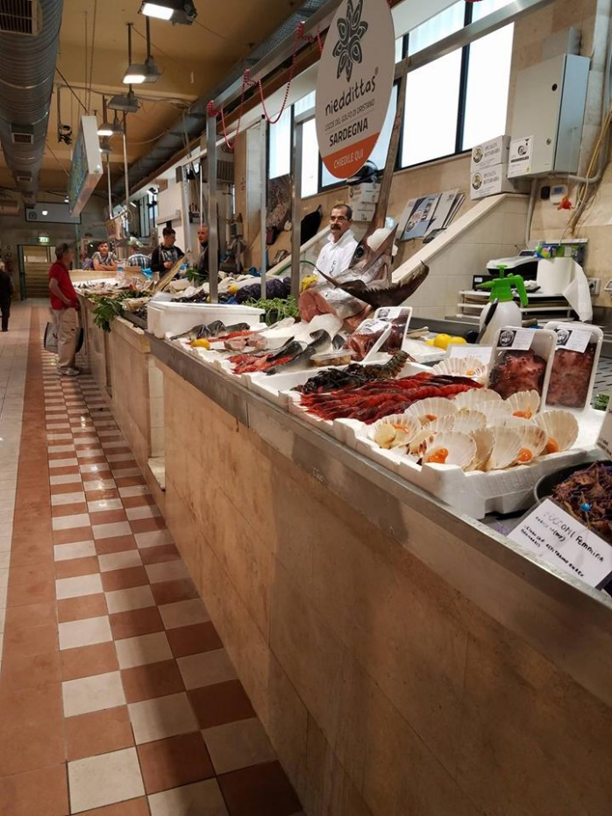
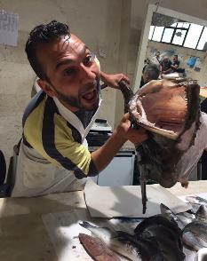
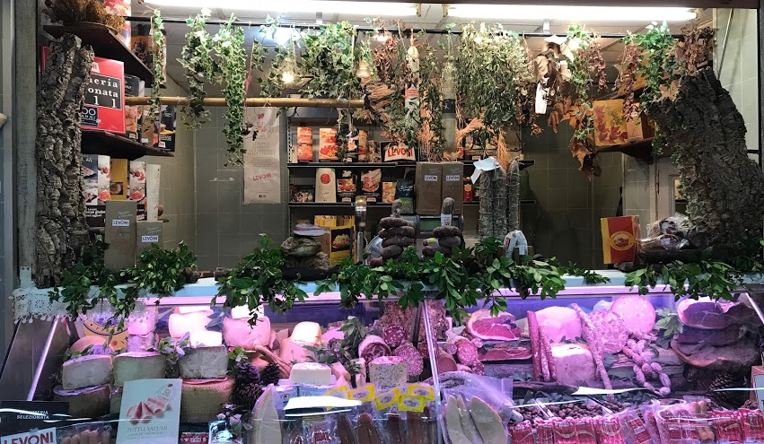
San Benedetto Market
San Benedetto Market
238 vendors
Main source of fresh produce and local meats for residents of Cagliari
Lower level: fresh seafood, crustaceans, shellfish, etc.
Upper level: cheese, meat, fruits, vegetables, wine, dried goods, honey, pastries, traditional flatbread, etc.
Notes:
Horse is delicacy
Locals were so kind
Insert pictures

Slide 19

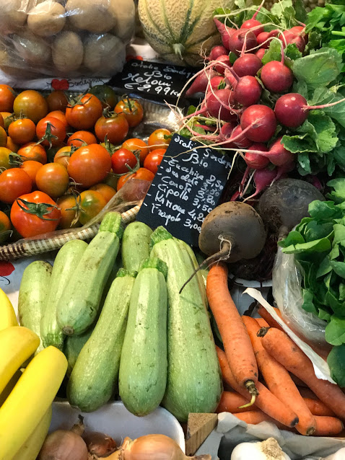
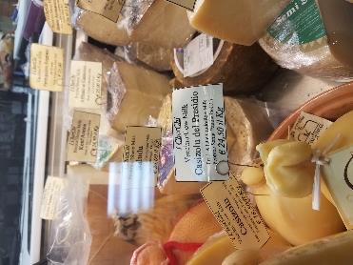
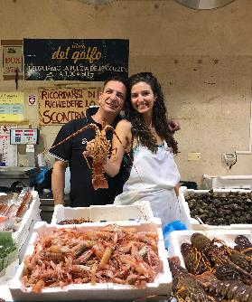
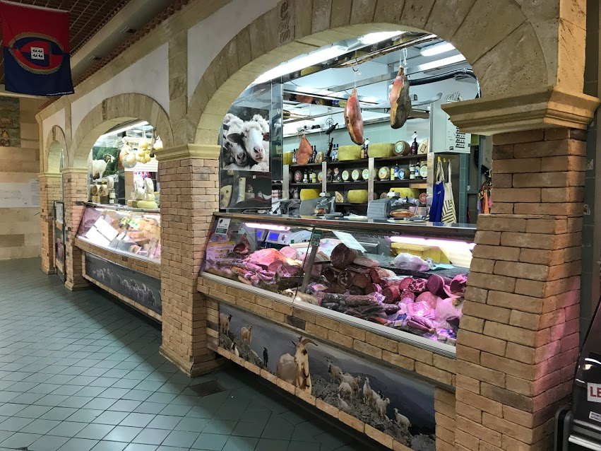
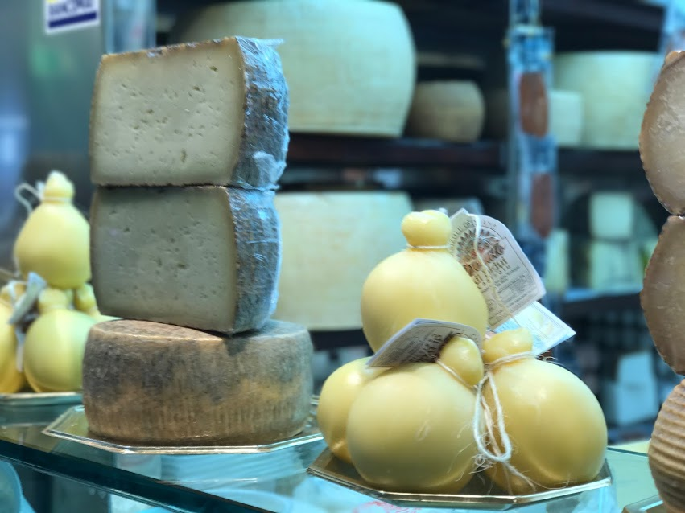

Slide 20
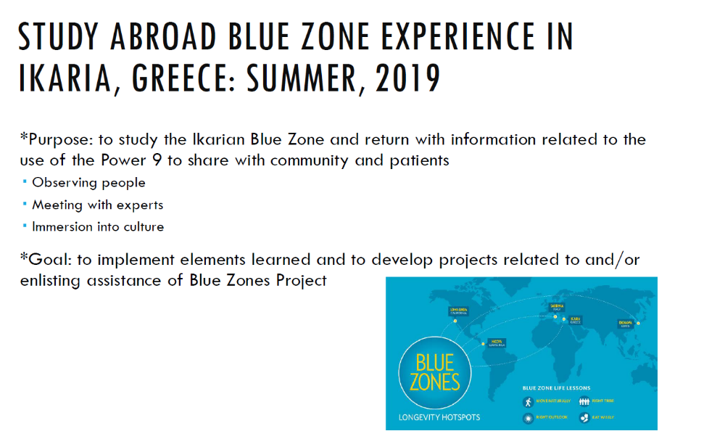

Slide 21
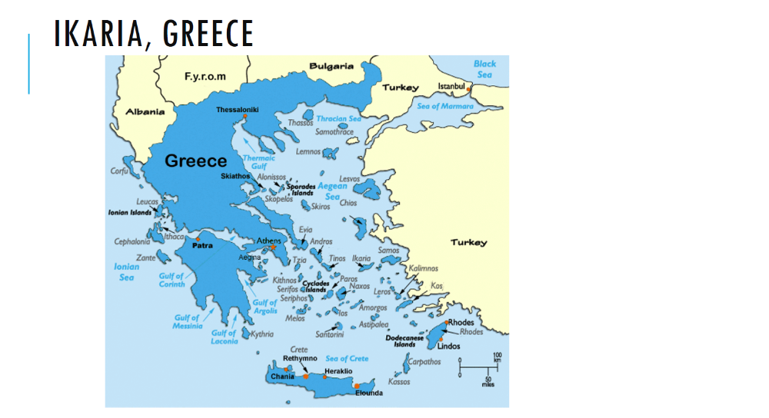

Slide 22
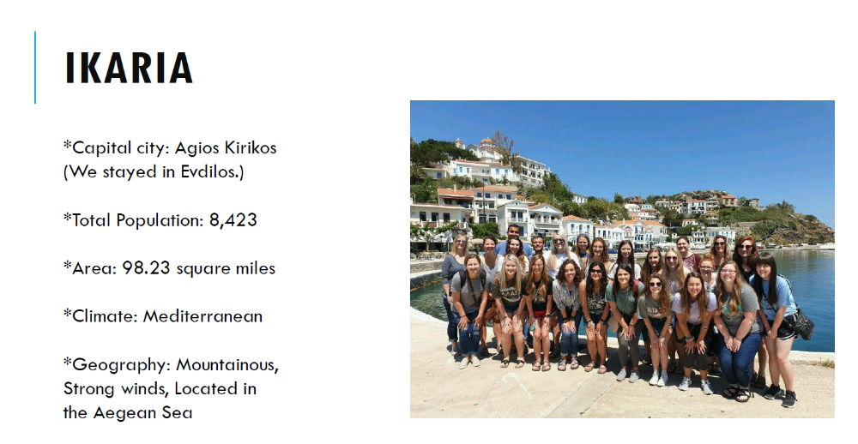

Slide 23
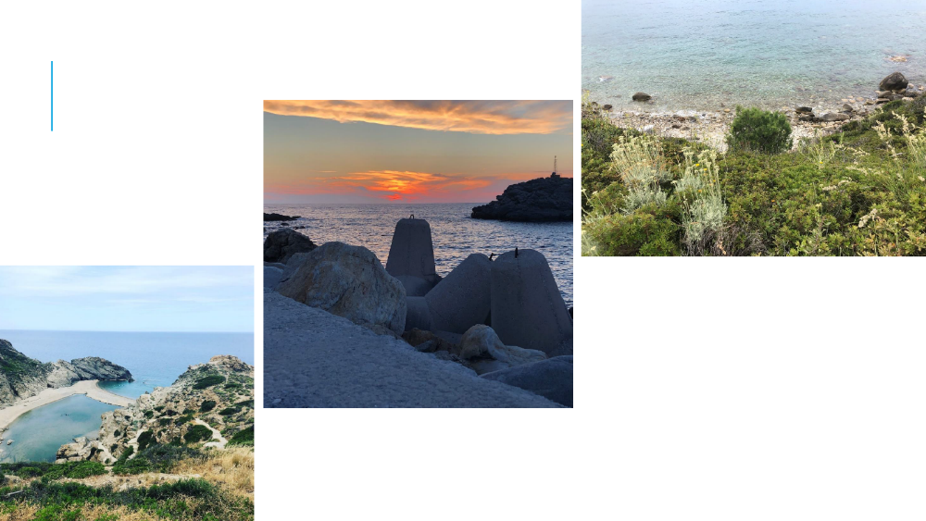

Slide 24
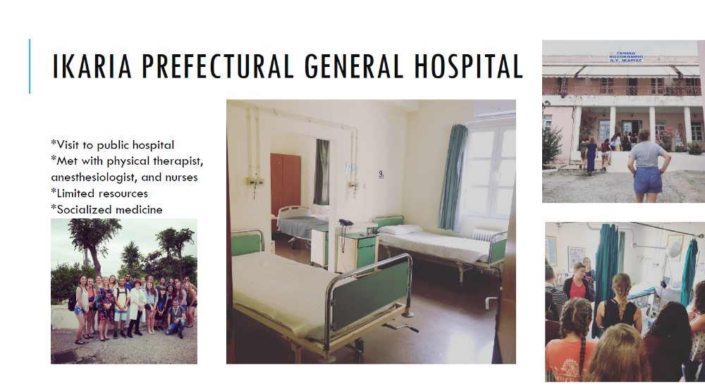

Slide 25
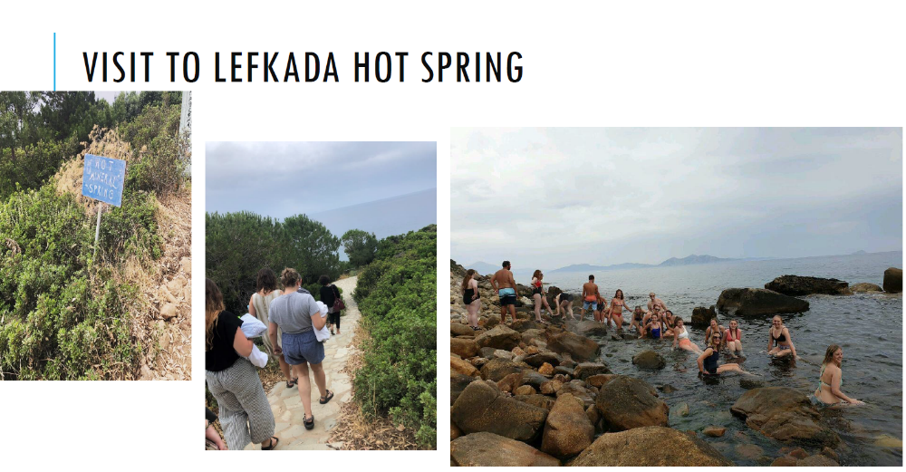

Slide 26
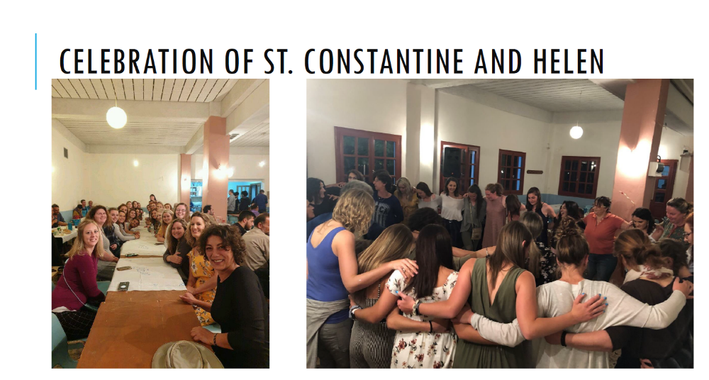

Slide 27
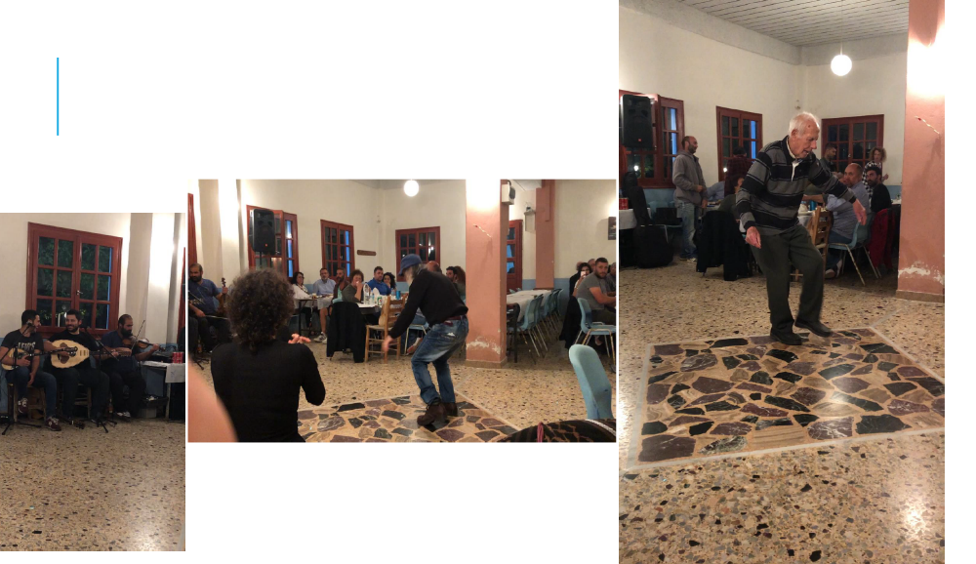

Slide 28
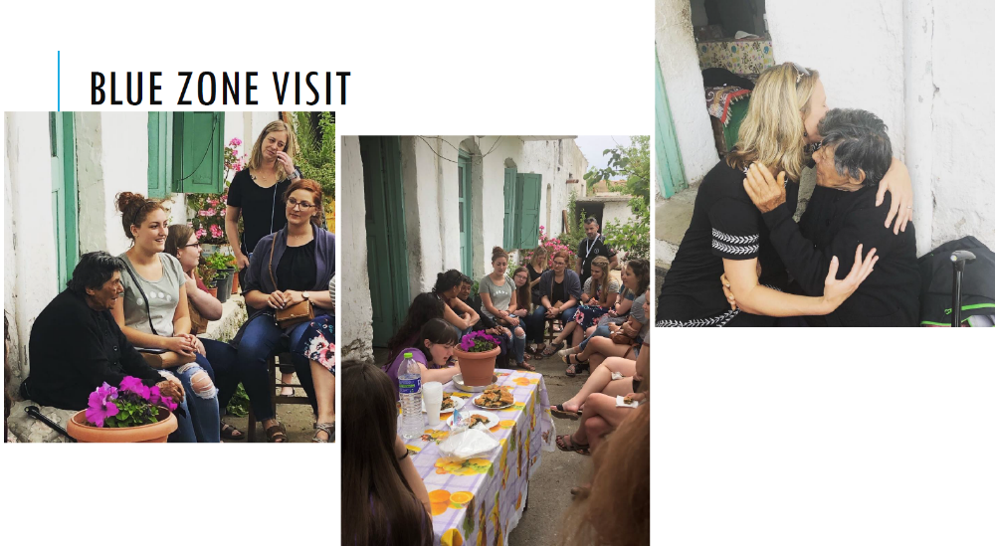

Slide 29
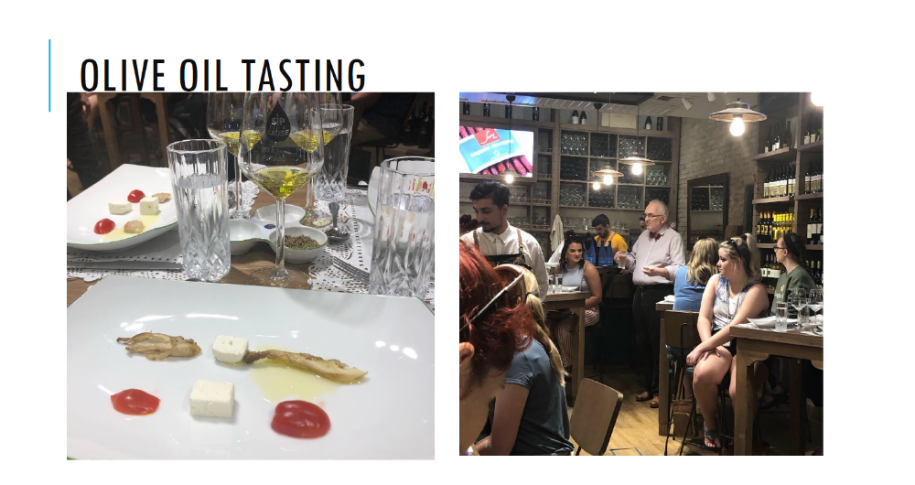

Slide 30
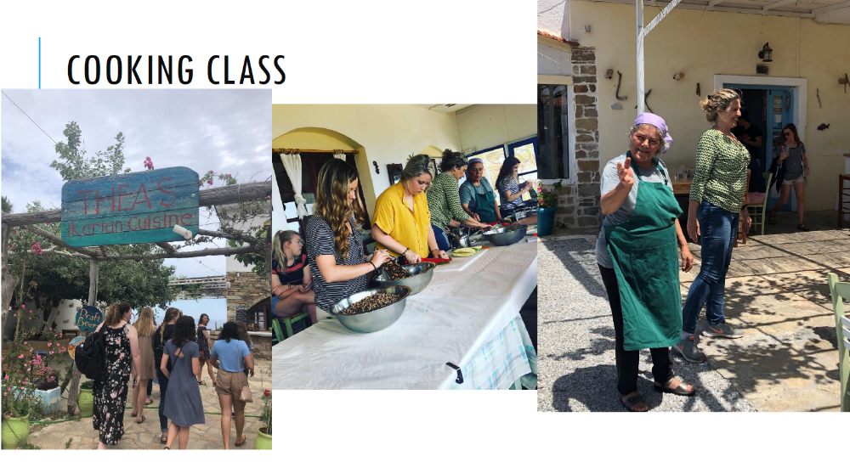

Slide 31
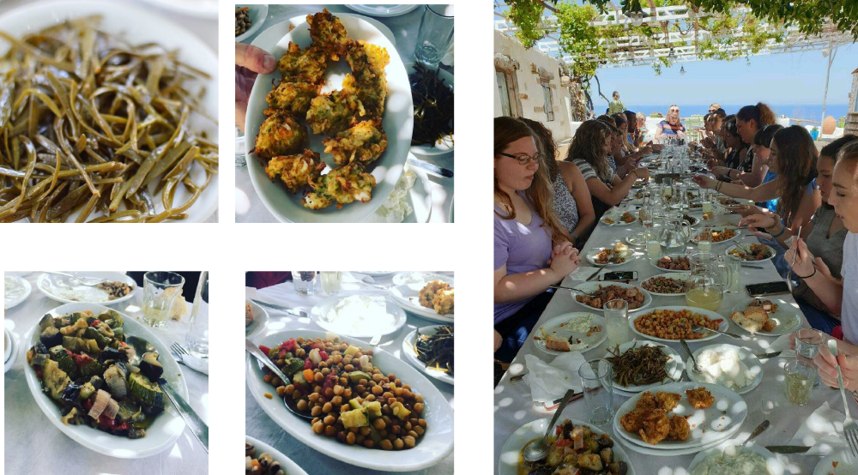

Slide 32

Background Information
Kentucky ranks 49th out of 50 states in terms of overall well-being
Overall well-being is based on 5 specified areas: purpose, social, financial stability, physical, and community
  Kentucky ranks poorly (40th or worse) in all areas except for community which ranks 29th

Slide 33
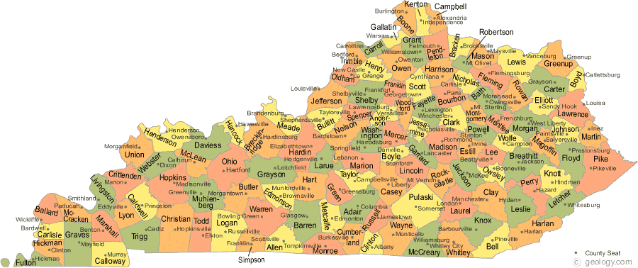
Why is this Important?
Statistics show that Kentucky has many physical ailments which impact well-being:
  Kentucky is #1 in cancer diagnoses in the United States
  Additional Statistics
    Chronic Lower Respiratory Disease #3
    Diabetes #4
    Kidney Disease #6
    Heart Disease #10
    Stroke #12

Slide 34
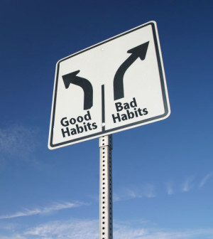
Why is this Important?
Unhealthy lifestyles choices are leading causes of these health issues
  Smoking rate in Kentucky – 26.5% which is 45.6% higher than the national average
  Obesity rate in Kentucky – 67.3% which is 5.49% higher than the national average
Other lifestyle issues include:
  Alcohol/drug abuse
  Poor nutrition
  Lack of exercise
  Stress

Slide 35
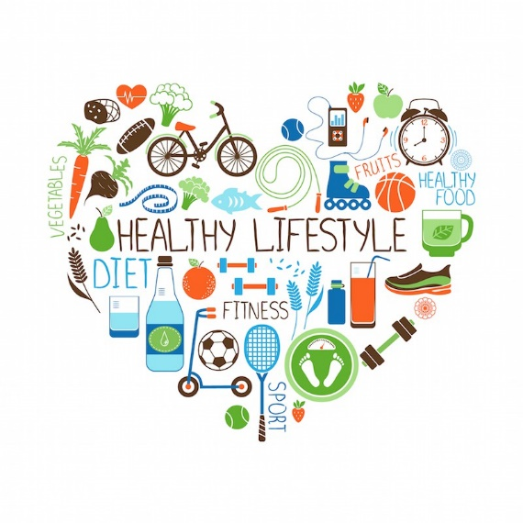
What Can be Done?
Implement changes based on needs/desires of
Murray/Calloway County
Potential improvements:
  Activities to boost community involvement
    Walking groups, insurance plan changes
  Community garden(s)
  Adding healthy options to grocery stores and restaurant menus
  Improving/adding pedestrian/biking paths and parks

Slide 36

Research Projects
-Website Development
-Barriers Survey
-Interviews
-Teaching at Elementary Schools
-Faculty in Nursing, OSH, Psychology, Exercise Science, and Nutrition
-Students from all disciplines

Slide 37

My Prescription

Slide 38



Big CONCEPTS
1. Move Naturally
2. Right Outlook
3. Eat Wisely
4. Belong

Slide 39


Move naturally
Physical activity is one of the most important things you can do for your health.
Adults need at least 150 minutes of moderate-intensity physical activity a week, such as 30 minutes a day, 5 days a week.
Adults also need 2 days of muscle-strengthening activity each week.
(CDC, 2023)
*Discuss: How can you incorporate this into your life?

Slide 40






Right outlook
Purpose: an abiding intention to achieve a long-term goal that is both personally meaningful and makes a positive mark on the world
-a long-term aim that is meaningful to the self—but goes beyond the self, aiming to make a difference to the broader world. We might find purpose in fighting poverty, creating art, or making people’s lives better through technology
-who we are, what we value, and what we want out of life (Greater Good Science, 2026)
*Discuss: How can you incorporate this into your life?

Slide 41




Right outlook
Decrease stress: Chronic stress can harm your body and mind by releasing stress hormones for too long. This can lead to issues such as headaches, poor sleep, and heart disease. It also can weaken your immune system. And it can lead to changes in daily habits, such as getting less physical activity. This can make it harder for your body to stay healthy and recover from illness. (Mayo Clinic, 2026)
*Discuss: How can you incorporate this into your life?

Slide 42




Eat wisely
Good nutrition is essential to keep current and future generations of Americans healthy across the lifespan. Poor nutrition is connected to a poor economy.
Healthy eating means focusing on whole, nutrient-dense foods. It emphasizes protein, dairy, vegetables, fruits, healthy fats, and whole grains. (CDC, 2026)
Eat plenty of vegetables and fruit; they are important sources of vitamins, minerals, dietary fiber, plant protein, and antioxidants.
People with diets rich in vegetables and fruit have a significantly lower risk of obesity, heart disease, stroke, diabetes and certain types of cancer. (WHO, 2026)
*Discuss: How can you incorporate this into your life?

Slide 43



Connection
Belonging: millions of people in the U.S. experience chronic loneliness, which is strongly associated with lower self-reported physical health, mental health, and quality of life. It is also related to higher rates of depression, anxiety, insomnia, and suicide ideation.
Research has shown that the psychological and physical health benefits of social contact are so great that they can even outweigh the harmful effects of other risk factors and boost life expectancy.
Much of modern-day “connectivity” is less concerned with making genuine connections and more about being seen as part of a tribe—more often than not, one whose members know very little about one another on a personal level. (UC Berkeley, 2026)
Opportunities: Home/Family, Social circles/friends, Volunteer, Work relationships, Skill-building/self-development environments, Hobbies/interest-based environments, Church/spiritual communities, Extra-curriculars, Clubs/classes
*Discussion: How can you incorporate this into your life?

Slide 44

And my Two cents
-Sleep: Experts recommend that adults sleep between 7 and 9 hours a night. Adults who sleep less than 7 hours a night may have more health issues than those who sleep 7 or more hours a night. Sleeping more than 9 hours a night is not necessarily harmful and may be helpful for young adults, people who are recovering from sleep deprivation, and people who are sick.
-People who do not sleep enough or wake up often during the night may have a higher risk of Coronary heart disease, High blood pressure, Obesity, Stroke
-Not getting enough sleep or enough high-quality sleep can lead to problems focusing on tasks and thinking clearly.
-Not getting enough quality sleep can lead to higher levels of the hormones that control hunger, including leptin and ghrelin, inside your body; Decreased ability to respond to insulin; Increased consumption of food, especially fatty, sweet, and salty foods; Decreased physical activity; Metabolic syndrome (NIH, 2026)
-*Discussion: How can you incorporate this into your life?

Slide 45


Fresh Air/Time Outdoors:
*increased greenspace exposure was associated with decreased salivary cortisol −0.05 (95% CI −0.07, −0.04), heart rate −2.57 (95% CI −4.30, −0.83), diastolic blood pressure −1.97 (95% CI −3.45, −0.19), HDL cholesterol −0.03 (95% CI −0.05, <-0.01), low frequency heart rate variability (HRV) −0.06 (95% CI −0.08, −0.03) and increased high frequency HRV 91.87 (95% CI 50.92, 132.82), as well as decreased risk of preterm birth 0.87 (95% CI 0.80, 0.94), type II diabetes 0.72 (95% CI 0.61, 0.85), all-cause mortality 0.69 (95% CI 0.55, 0.87), small size for gestational age 0.81 (95% CI 0.76, 0.86), cardiovascular mortality 0.84 (95% CI 0.76, 0.93), and an increased incidence of good self-reported health 1.12 (95% CI 1.05, 1.19). Incidence of stroke, hypertension, dyslipidaemia, asthma, and coronary heart disease were reduced. (Twohig-Bennett & Jones, 2018)
*Discussion: How can you incorporate this into your life?

Slide 46


Slide 47


Slide 48


Slide 49
References
Blue Zones Project. (2016). Can your city make you healthy? 15 Iowa Blue Zones Project communities transform street design to meet demand. Retrieved from https://www.prnewswire.com/news-releases/can-your-city-make-you-healthy-15-iowa-blue-zones-project-communities-transform-street-design-to-meet-demand-for-walkable -livable-neighborhoods-300340312.html
Capstone Nutrition. (n.d.). Life Improved. Retrieved from http://capstonenutrition.com/
Centers for Disease Control and Prevention. (n.d.). Stats of the state of Kentucky. Retrieved from https://www.cdc.gov/nchs/pressroom/states/kentucky/kentucky.htm
GAL: Sarcidano Barbagia Di Seulo. (n.d.). Municipality of Escolca. Retrieved from https://translate.google.it/translate?hl=it&sl=it&tl=en&u=http%3A%2F%2Fwww.galsarcidanobarbagiadiseulo.it%2Fterritorio%2Fescolca
Gallup-Healthways Well-Being Index. (2017). State of American well-being: 2016 state well -being rankings. Retrieved from http://info.healthways.com/hubfs/Gallup-Healthways%20State%20of%20Americ%20Well-Being_2016%20State%20Rankings%20vFINAL.pdf?t=1501018388439&__hstc=56314740.228bf7d23024a8da83be55b9d861cd28.1501214818591.1501214818591.1501214818591.1&__hssc=56314740.6.1501214818592&__hsfp=2735517815
Roundtable on Population Health Improvement, Board on Population Health and Public Health Practice, & Institute of Medicine. (2015). Business engagement in building healthy communities: Workshop summary. Retrieved from https://www.ncbi.nlm.nih.gov/books/NBK298907/pdf/Bookshelf_NBK298907.pdf
Sardinia. (n.d.). In Encyclopedia Britannica. Retrieved from https://www.britannica.com/place/Sardinia-island-Italy
https://www.cbsnews.com/news/blue-zones-do-people-who-live-in-certain-areas-live-longer/
Photographs provided by students who attended this program

