Slide 1
Welding and Hot Work

Slide 2
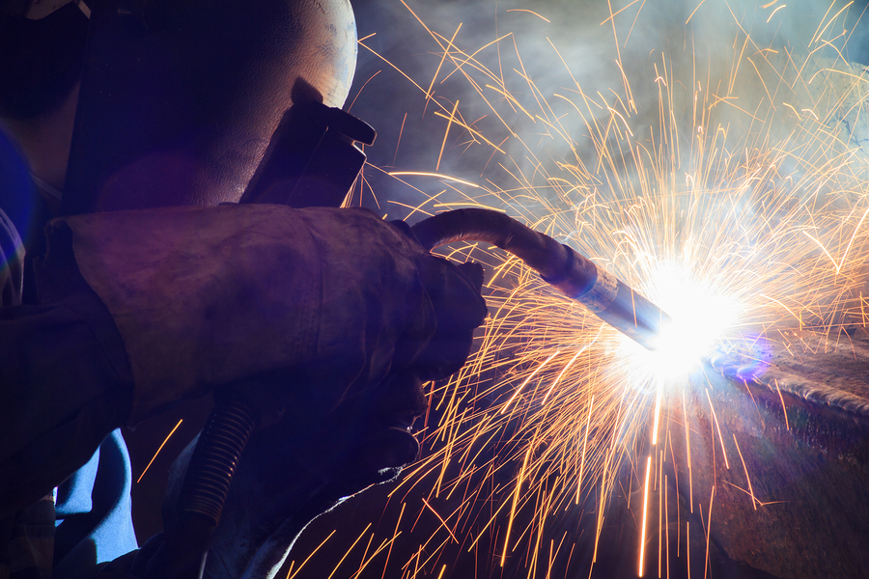
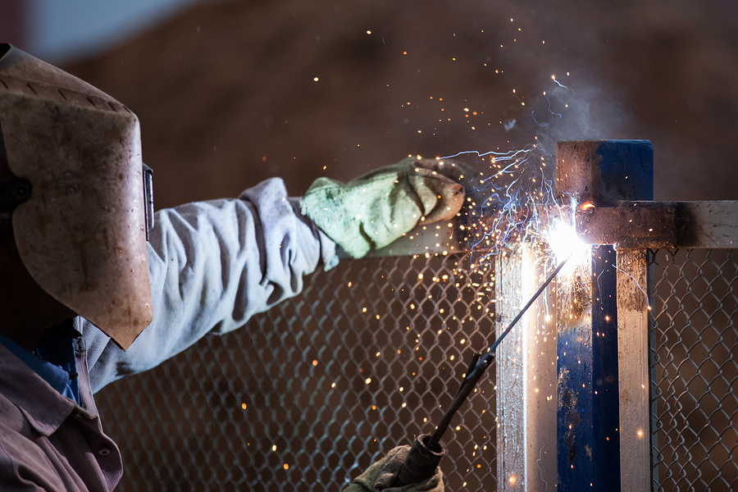
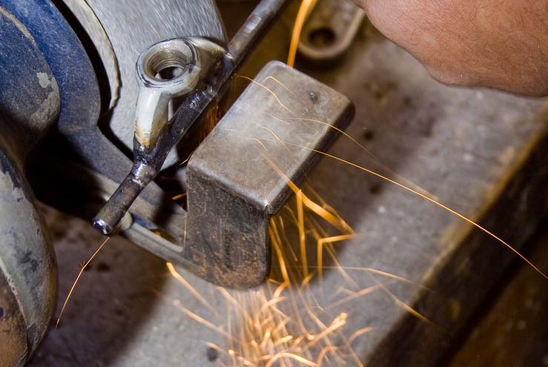
What is Hot Work?
Introduction
Hot work is any work process that produces flames or sparks that present a fire ignition hazard to the surrounding environment and personnel.
Examples of hot work:
Gas torch welding and cutting uses a flame to join or cut metal.
Arc welding and cutting uses an electric arc between a metal electrode and a base material to join or cut metal.
Grinding uses a grinding wheel that rotates at high speed to cut metal.
Brazing and soldering uses heat to melt a filler metal that is used to join metal.

Slide 3
Course Overview
Introduction
Hazards of Hot Work
Hazard Prevention Safeguards
Personal Protective Equipment (PPE)
Arc Welding
Torch Welding, Cutting, and Brazing
Cylinder Handling and Storage

Slide 4
Hazards of Hot Work
1
What you need to know:
The hazards associated with hot work
Which environments require unique hazard prevention training and precautions
Notes:
Hot work poses significant safety and health risks. As you work through this portion of the training, you’ll need to know:
The hazards associated with hot work, including fire, flammable gases, toxic metal coatings, electric shock, and intense light.
Which environments require unique hazard prevention training and precautions prior to beginning hot work.
The risks discussed in this section highlight the importance of safety precautions.

Slide 5
Hazards Associated with Hot Work
1 Hazards of Hot Work
Hot work presents a variety of hazards.
Before hot work can begin, your supervisor will identify the hazards in your workplace.
Fire
Intense heat, sparks, or metal splatter produced during hot work can create fire hazards.
Electric shock
If you touch two metal objects containing voltage, you will become a part of the electrical circuit. Higher voltages increase the risk of injury or death.
Arc flash
Arc flash occurs when an electric current leaves its intended path and travels through the air from one conductor to another or to the ground.
Burns
Radiant energy, sparks, or metal splatter can cause serious burns.
Flammable gases
If allowed to accumulate, flammable gases can flash or explode with catastrophic results.
Intense light
The incredibly bright light of arc welding can cause serious eye damage.

Slide 6
Hazards Associated with Hot Work
1 Hazards of Hot Work
Combustion creates gases, and molten metal releases fumes, both of which are dangerous to inhale. However, certain metals and coated surfaces are especially prone to emitting toxic fumes and gases.
Toxic metals and coatings:
Proper ventilation and respiratory protection are critical when performing hot work on materials containing the following:
Zinc
Chromium
Lead
Cobalt
Cadmium
Mercury
Beryllium

Slide 7
Environments with Special Hazard Considerations
1 Hazards of Hot Work
The hazards of hot work intensify in certain environments, such as wells or other confined spaces.
Potential hazards in oil or gas wells:
Flammable or combustible gases, vapors, and liquids
Toxic gases in deadly amounts
Hazards in confined spaces:
Limited escape routes
Limited visibility, which impedes awareness of injuries and delays emergency response
Limited ventilation, presenting a greater risk of exposure to harmful fumes
Displaced oxygen caused by welding flames in a confined space, which can be fatal

Slide 8
Hazard Prevention Safeguards
2
What you need to know:
Roles and responsibilities
Administrative procedures
General hazard controls
Additional controls
Safety restrictions
Notes:
In this section, we will look at best practices for keeping the workplace safe, including safety procedures and responsibilities.
You will need to know the following:
the roles and responsibilities of management, appointed supervisors, and welders
the administrative procedures that must precede any hot work activity
the general hazard controls used to keep you and co-workers safe before, during, and after hot work
the additional controls for environments with special hazard considerations
safety restrictions associated with hot work.
These policies and procedures are an essential part of a safe work environment

Slide 9
Roles and Responsibilities
2 Hazard Prevention Safeguards
You, supervisors, and management all have the responsibility to assure a safe environment for hot work.
The employee:
Lays out the work area
Keeps the work area clean
Follows fire prevention and other safety controls
Follows related procedures, such as lockout/tagout
Uses all personal protective equipment (PPE) properly
Uses all equipment properly
Reports any safety issues
The supervisor:
Conducts hazard assessments and identifies safety precautions
Communicates and enforces safety procedures
Assigns fire watches, if required
Secures authorizations
Assures that equipment is safe to use
Tells the employee when to proceed
Management:
Appoints a qualified supervisor
Establishes the proper locations, policies, and procedures
Assures that employees have the training they need to work safely
Advises contractors of hazards

Slide 10
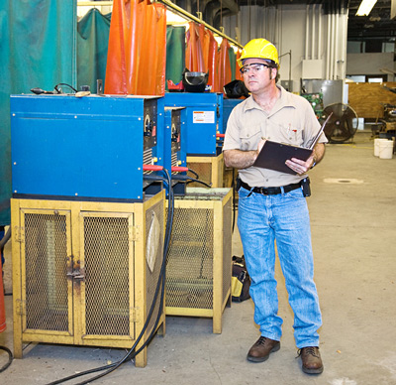
Hazard Assessment
2 Hazard Prevention Safeguards
Your supervisor must take certain precautions before hot work begins. The most important of these is the hazard assessment.
The hazard assessment considers:
All the activities required for completing the task.
The hazards associated with each of those activities.
Any additional environmental hazards.
*
The hazard assessment will guide the choice of hazard controls and PPE.

Slide 11
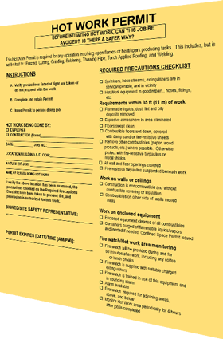
Administrative Procedures
2 Hazard Prevention Safeguards
Next, your supervisor will perform the following administrative tasks.
Notification:
Notify area management and employees of planned hot work activities.
Permits:
To certify that hazards are thoroughly identified and addressed, acquire and complete hot work permits.
Each separate operation requires a permit.
Sometimes a new permit is needed for each shift or if new hazards are introduced.
The organization should keep permits for at least one year after the hot work has been performed.

Slide 12
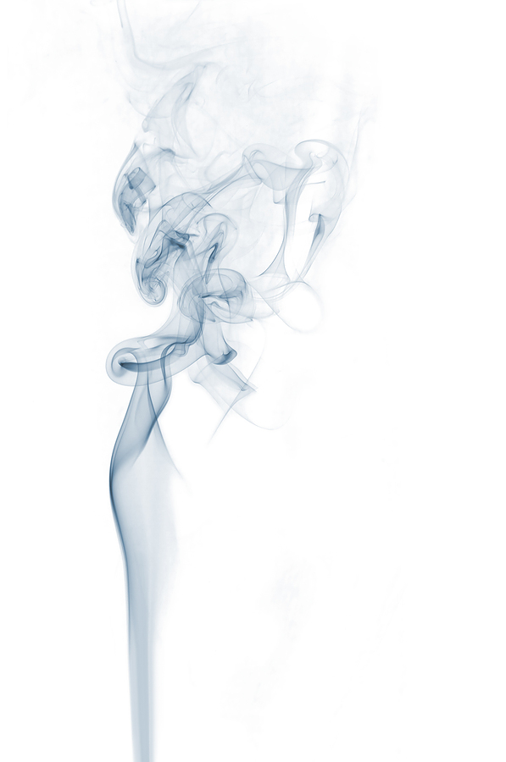
Hazard Controls
2 Hazard Prevention Safeguards
Based on the hazard assessment, your supervisor will establish hazard controls for each risk.
Controlling combustible materials:
Remove all combustible materials 35 feet from the work area.
Move combustibles located on the opposite side of partitions and ceilings that will be subject to welding or cutting.
Avoid unmovable combustible materials, such as wooden floors.
If unable to remove or avoid fire hazards:
Cover combustible floors or materials with fire blankets or other suitable non-combustible material to contain slag and sparks.
Use guards.
Establish restrictions.
In some cases, hot work may be prohibited entirely.

Slide 13
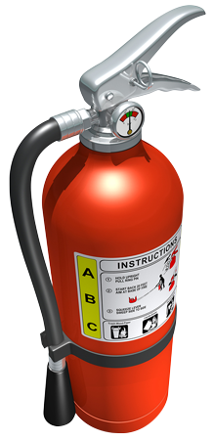
Additional Fire Prevention Measures
2 Hazard Prevention Safeguards
Fire watch: Establish a fire watch in areas where fires might develop. Continue the watch for at least 30 – 60 minutes after completion of hot work.
Fire extinguishers: Provide at least one 10-pound ABC fire extinguisher in each hot work zone.
Ducts and conveyer systems: Shut down ducts and conveyor systems that might carry sparks.
Atmosphere control: Monitor the air, checking for flammable or explosive gases or vapors. If necessary, purge and inert the atmosphere.
Safe disposal: Provide metal buckets or containers for safe disposal of hot work debris.

Slide 14
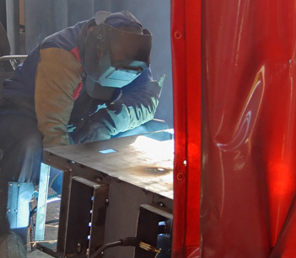
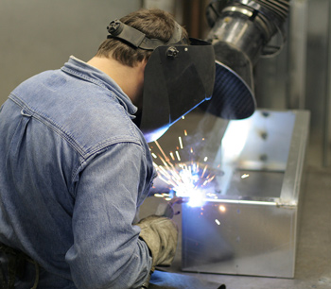
Other Hazards
2 Hazard Prevention Safeguards
Welding arc rays: Position welding curtains to protect employees from intense light. Provide the proper shade of lens.
Electrical shock: Keep working conditions dry, and provide proper PPE.
Arc flash: Provide high-resistance grounding and proper PPE.
Burns: Install guards, and provide proper PPE.
Fumes and other toxic byproducts: Properly ventilate work areas, and provide adequate respirators.
Toxic coatings: When possible, strip toxic coatings from metal before beginning hot work.
A welding curtain shields employees from the direct rays of arc welding and cutting operations.
A welder uses a local exhaust duct to quickly remove toxic fumes and gases.

Slide 15
Controlling Hazards Around Confined Spaces
2 Hazard Prevention Safeguards
Certain environments, such as well sites, vessels, and other confined spaces, require additional precautions.
Move all ignition sources outside the hot work area.
Use local exhaust ventilation to keep exposures within acceptable limits.
Follow your organization’s respiratory protection program.
Your supervisor will arrange for monitoring to evaluate air quality, potential contaminants, and ignition sources.
Before beginning hot work on vessels that formerly contained flammable or toxic materials, thoroughly clean them.
Always vent and purge hollow spaces.
Assure that oxygen is not displaced, or use a supplied air respirator.
Do not bring cylinders or welding machines inside of confined spaces.
Follow your organization’s policies for working in confined spaces.

Slide 16
Safety Restrictions
2 Hazard Prevention Safeguards
In some conditions, you should never perform hot work.
Never weld in the following locations:
Rooms where fire sprinklers are impaired
Spaces with potentially explosive atmospheres
Areas near the storage of large quantities of readily ignitable materials
Never weld on the following materials:
Metal that has combustible covers or layers
Metal in close proximity to combustibles

Slide 17
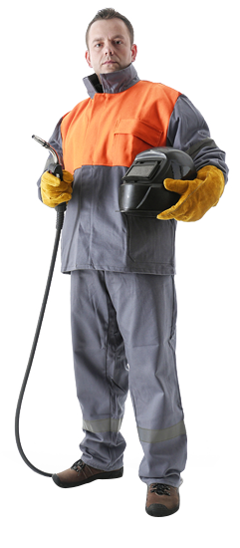
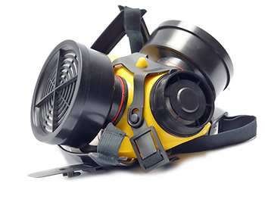
Before Beginning Any Hot Work
2 Hazard Prevention Safeguards
Wait for your supervisor to finalize the permit.
Only work on equipment if properly trained and authorized by the organization.
Inspect all PPE.
Inspect all hot work equipment.
Follow the lockout/tagout program requirements.
Follow respiratory protection requirements.

Slide 18
Personal Protective Equipment (PPE)
3
What you need to know:
Common PPE designed for hot work
How to select eye protection
The proper use of respirators
Notes:
Personal protective equipment, or PPE, is essential for hot work operations.
This part of this training will address:
common PPE designed for hot work
how to select eye protection
the proper use of respirators to reduce exposure to hazardous fumes and vapors.
Keep yourself safe by learning and following all PPE requirements.

Slide 19
Common PPE
3 Personal Protective Equipment (PPE)
Your supervisor will identify required PPE as part of the hazard assessment. Required PPE for hot work may include skin, body, and foot protection.
To protect against burns, cover all exposed flesh.
PPE that protects against electric shock includes insulated gloves and rubber-soled shoes.
Buttonable collar
Welding hood
with adjustable lens filter
Fire resistant gloves
Fire resistant jacket
hanging outside of pants without open pockets
Fire resistant trousers
without cuffs on pant legs
Leather high-top boots with steel toes

Slide 20
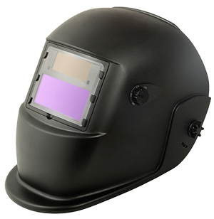
Eye Protection
3 Personal Protective Equipment (PPE)
Your supervisor will specify the type of eye protection needed for the task.
Types of eye protection:
Welding hoods with properly shaded lenses
Cutting or burning goggles for torch cutting
Full face shields for grinding
Safety glasses worn under welding hoods or face shields when grinding
Auto-darkening lenses:
Auto-darkening lenses provide continuous protection by adapting to varying levels of light.
If using an auto-darkening lens:
Check the manufacturer specifications to confirm that it is rated for the correct intensity.
Before starting work, check that the battery power is sufficient.

Slide 21
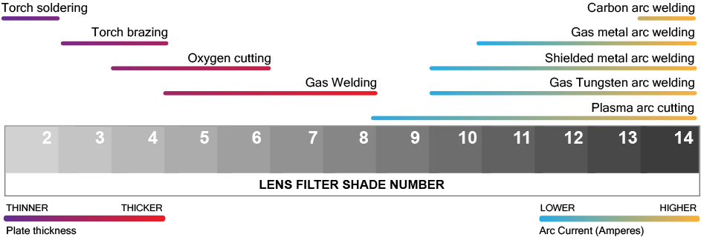
Protective Lens Shading
3 Personal Protective Equipment (PPE)
Lens filter shade numbers range from 2 – 14. Higher numbers providing greater protection. The chart below shows the recommended lens filter shade number for specific types of hot work.
Notes:
Different intensities of light require different levels of protection.
Light intensity varies based on the type of hot work activity, the thickness of the metal being worked on, and the arc current used.
As this chart shows, gas welding creates more light than torch soldiering because it is used on thicker metal.
Because carbon arc welding uses a high current, it requires the highest level of protection.
Both the employees performing the hot work and observers must wear the recommended level of eye protection.

Slide 22
Respiratory Protection
3 Personal Protective Equipment (PPE)
Filter-type respirators use cartridges to filter incoming air and remove contaminants.
Uses:
They are required for open-air hot work with metals containing toxic substances such as galvanized steel, zinc, or chromium.
They will not provide adequate protection in confined spaces lacking sufficient ventilation.
*
!
Consult manufacturer specifications to determine the appropriate type of cartridges.
REMEMBER: You must be trained and authorized before using a respirator. Only wear a respirator designed and rated for the hazards involved.

Slide 23
Arc Welding
4
What you need to know:
How to safely handle arc welding tools
Safety procedures
Notes:
Arc welding is a process that manipulates electricity to melt metal. The welder creates an electrical arc between an electrode—which is charged by a welding machine—and a base material.
The following slides address how to safely handle arc welding tools and what safety procedures to follow.
Learn how to keep yourself and those around you safe when arc welding.

Slide 24
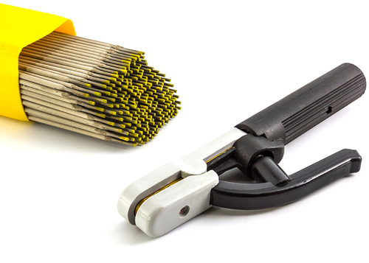
The Electrode Holder
4 Arc Welding
Check that all components of arc welding are in good condition, starting with the electrode holder.
Electrode holder requirements:
Specifically designed for arc cutting and welding
Properly insulated
Able to safely handle the maximum current
Safe practices:
When done welding or if leaving the holder unattended, remove and properly dispose of the electrode to prevent contact with people or conducting objects.
NEVER dip a hot electrode or electrode holder in water.
The welder inserts one of these electrodes (right) into the electrode holder (left).

Slide 25
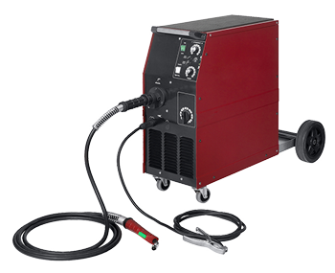
Cables
4 Arc Welding
Before starting the welding machine, check the condition of the cables.
Cable requirements:
Completely insulated
Flexible
Capable of handling the maximum current requirements
Repair or splices:
Areas that have been repaired or spliced must be at least 10 feet away from the electrode holder, unless the connectors and connecting lugs have the same level of insulation as the cable.
One cable carries electricity to power the electrode, and the other grounds the welding machine.

Slide 26
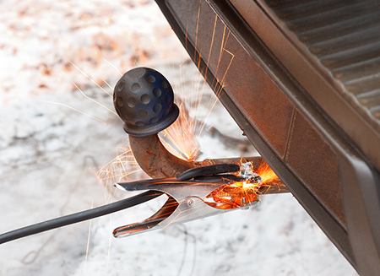
Cables
4 Arc Welding
Additional cable requirements:
Ground the welding machine properly.
Keep cables clear of walkways, ladders, and stairways. For example, they can be strung overhead with non-metallic hangers.
Immediately remove all damaged and worn cables from service until properly repaired.
Signs of improper grounding include sparks, arcs, and heat.

Slide 27
Additional Procedures
4 Arc Welding
Follow your organization’s lockout/tagout program and any PPE requirements.
Before you begin:
Inspect your PPE.
Inspect all equipment to assure that it meets the manufacturer’s specifications.
Make sure that the welding machine’s power supply has a circuit breaker or can be easily disconnected.
When you are finished:
Shut off the welding machine at the end of each shift and whenever the machine is moved.
Assure that stored energy is released in accordance with the manufacturer’s specifications.

Slide 28
Torch Welding, Cutting, and Brazing
5
What you need to know:
Equipment inspection procedures
Safe use of torch cutting equipment
Safety guidelines for supply hoses
Safe use of cylinder valves
Notes:
Torches used for welding, cutting, and brazing use gases and gas-fuels, which are stored in cylinders, piped through hoses, and heated to metal-melting temperatures.
The following section addresses equipment inspection procedures, safe use of torch cutting equipment, safety guidelines for supply hoses, and safe use of cylinder valves.
The safe handling of cylinders will be explored in more detail in the next section.
These guidelines will help you prevent injuries.

Slide 29
Inspection and General Torch Use
5 Torch Welding, Cutting, and Brazing
Before torch welding, cutting, or brazing, inspect all equipment. Regularly follow preventive maintenance procedures, and consult the manufacturer’s specifications.
Pre-shift inspection:
Torches and hoses: Check for leaks, damage, and loose connections.
Oxygen cylinders and fittings: They must be properly labeled, distinguishable, and free of oil and grease.
Welding apparatus: Make sure all components are clean and free of oil and grease.
Valves
Regulators
Maintenance:
Tag and remove defective, damaged, or worn equipment from service. Either repair or discard it.
Properly clean clogged torch tips.
Safe torch use:
Use flashback arrestors.
Light torches only with approved tools.
When finished working, shut off valves and relieve hose pressure.

Slide 30
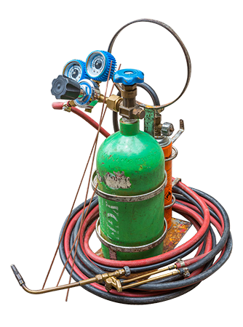
Safe Hose Preparation and Use
5 Torch Welding, Cutting, and Brazing
Hose preparation:
Keep hoses clear of walkways, ladders, and stairways.
For example, you can string hoses overhead using non-metallic hangers.
You can tape parallel lengths of hose together to prevent tangling, but do not tape more than 1/3 of each 12-inch section.
Check that hose couplings cannot be disconnected with a pull. Separating them should require a twisting motion.
Safe hose use:
Do not use the same hose for different materials.
Oxygen and fuel-gas hoses are not interchangeable.
Do not use a single hose with more than one gas passage.
When done with a task, relieve hose pressure.
When you are finished working, store your hose in a ventilated area or box.

Slide 31
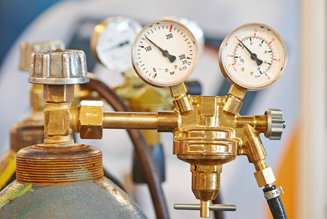
Using the Cylinder Valve
5 Torch Welding, Cutting, and Brazing
Proper use of cylinder valves keeps you safe and keeps the equipment working longer.
Always open valves slowly and carefully.
When opening valves, stand to the side, not to the front.
Do not open fuel-gas cylinders near ignition sources.
Do not open acetylene cylinders too far:
¾ of a spindle-turn or less is ideal.
Never turn the spindle more than 1.5 times.
Before you connect a valve to a regulator, open the valve a crack and then quickly close it. This allows any foreign material in the valve port to be discharged.

Slide 32
Cylinder Handling and Storage
6
What you need to know:
Hazard communication resources
Identification requirements
Safe handling practices
Guidelines for moving and storage
Environments and practices to avoid
Notes:
Gas cylinders are a necessary but dangerous part of hot work.
Because they are pressurized, an uncontrolled release of gas could turn a cylinder into a projectile. In addition, the gases can be toxic, oxygen-displacing, flammable, or explosive.
To protect yourself and those around you, you will need to know hazard communication resources, identification requirements, safe handling practices, guidelines for moving and storage, and environments and practices to avoid.
By handling cylinders with care, you can prevent accidents and injuries.

Slide 33
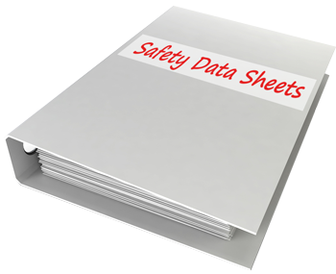
Cylinder Hazard Communication
6 Cylinder Handling and Storage
Before beginning work, you must fully understand the hazards in your work area. Hazard communication is a system for clearly conveying hazards to everyone who needs to know.
Training:
Your employer will provide hazard communication training.
Safety data sheets (SDSs):
SDSs include the manufacturer’s statement of origin, the contents of the cylinder, and the hazards of the contents.
PPE:
Use the SDS and your supervisor’s hazard assessment to select the proper PPE.

Slide 34
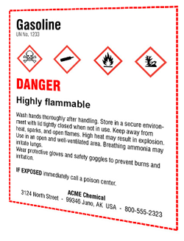
Cylinder Identification
6 Cylinder Handling and Storage
Tags:
Use status tags indicating if the cylinder is full, in use, or empty.
Labels:
All cylinders must have proper GHS-compliant labels that identify contents and classify hazards.
Signage:
Be aware of signs at storage areas, such as "Danger: Flammable. No sources of ignition, smoking, or open flames.”
Storage:
Store cylinders with caps and tags on.

Slide 35
Cylinder Valve Safety
6 Cylinder Handling and Storage
Close valves, bleed the lines, remove regulators, and replace valve safety caps:
When storing cylinders.
Before moving cylinders.
When a cylinder is empty.
When leaving cylinders unattended.
All cylinders must be equipped with a handle or wrench, so that they can be turned off immediately when necessary.

Slide 36
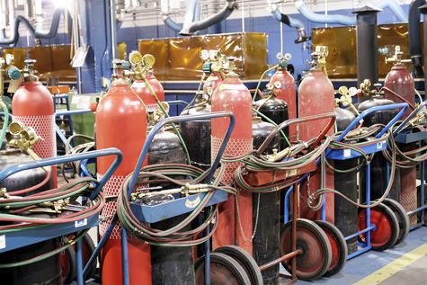
Moving Cylinders
6 Cylinder Handling and Storage
Prior to moving cylinders:
Get authorization.
Confirm the cylinders’ contents and review the SDSs for handling requirements.
Close valves, bleed the lines, remove regulators, and replace valve safety caps.
Make sure that your planned route is clear of obstacles.
While moving cylinders:
Use a cart designed for this purpose.
Use a chain to secure them to the cart.
Stay on designated pathways.
Never lay cylinders on their sides, and never roll them by hand.

Slide 37
Cylinder Storage Guidelines
6 Cylinder Handling and Storage
Store cylinders according to SDSs and local, state, and federal requirements.
Storage area requirements:
Cool and dry
Well-ventilated
Clean and free from combustible materials
Protected from recognizable hazards
Storage practices:
Limit access to authorized and trained persons.
Always keep cylinders upright.
Bleed the lines, remove regulators, and replace valve safety caps.
Follow safe practices for additional cylinders, whether full or empty.
Segregation:
Keep all cylinders and combustible materials 20 feet away from stairs, aisles, and elevators.
Keep combustible and flammable materials 20 feet away from all cylinders.
Keep oxygen cylinders separate from fuel-gas cylinders and combustible materials with one of the following:
A 5-foot, noncombustible barrier with a ½ hour fire-resistance rating
A 20-foot distance
Some gases have additional storage requirements.

Slide 38
Cylinder Storage and Handling Practices to Avoid
6 Cylinder Handling and Storage
Never:
Use cylinders for anything other than the intended use.
Move or store gas cylinders in confined spaces.
Position cylinders near ignition sources.
Position cylinders between electrical sources.
Hoist cylinders improperly, such as with magnets.
Use acetylene with a pressure greater than 15 psi gauge or 30 psi absolute.
Use hammers or wrenches to open cylinders that have fixed handwheels.
Strike an electrode against a cylinder when striking an arc.
Refill cylinders.
Mix gases in a cylinder.

Slide 39
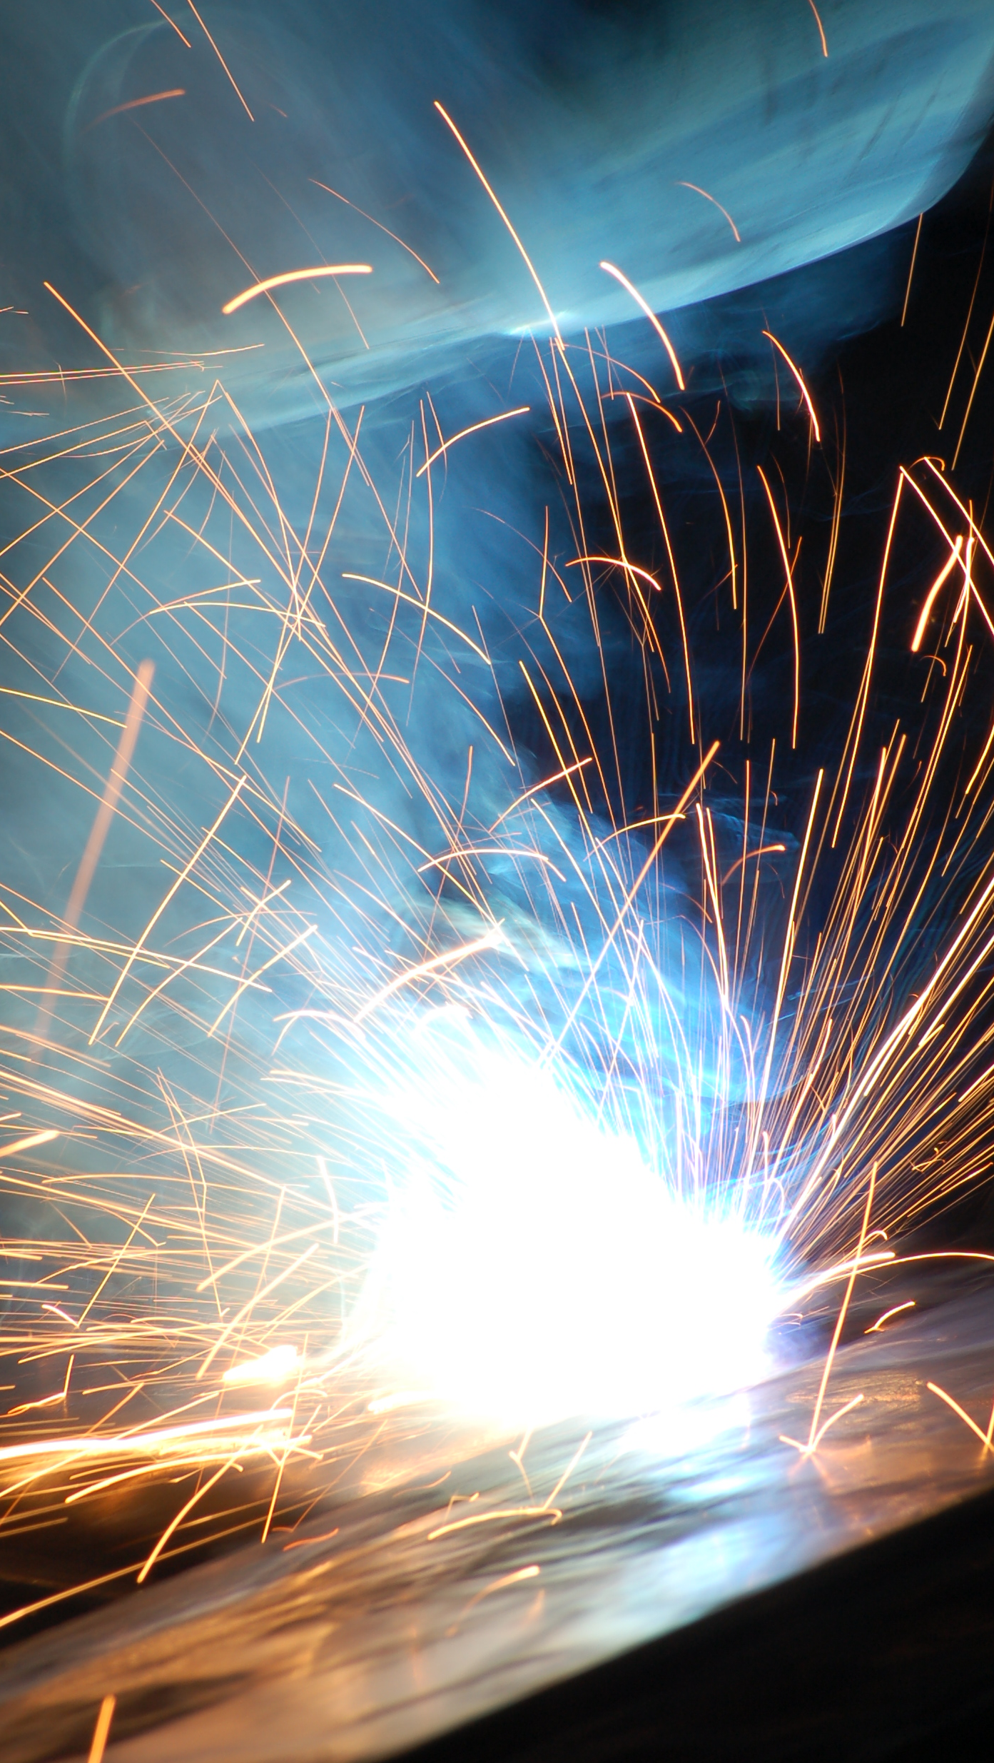
Summary
Summary
Hot work can be dangerous: Your active participation in workplace safety is essential.
Be able to recognize hazards: Be aware of the hazards in your workplace, and know what factors increase the danger. Know when it is too dangerous to perform hot work.
Be prepared: Be sure that you understand safety requirements and work practices before starting work.
Conduct inspections: Be confident that all parts of your equipment and PPE are undamaged and working properly.
Communicate: Communicate any hazards you discover to your supervisor and coworkers.

