Slide 1

Nathan B. Stubblefield Lecture
Dr. Bob Jackson
April 25, 2024

Slide 2
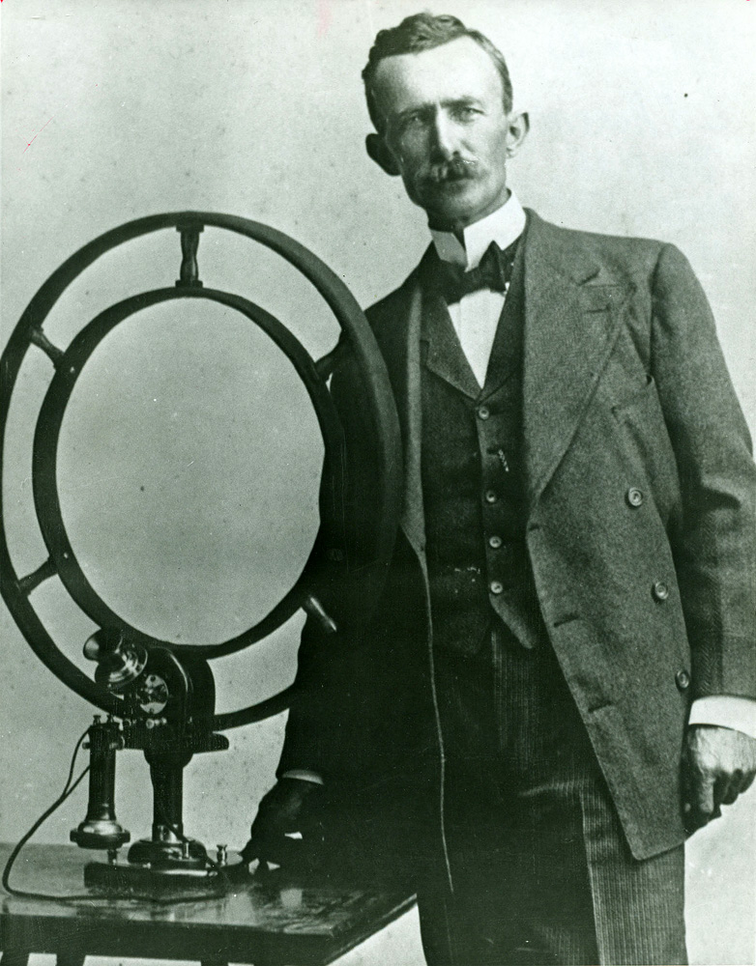
Nathan B. Stubblefield 1860-1928
First, Thank You
National Board of Advisors
Alumni, Sponsors and Supporters
Dr. Ramage, Faculty and Staff
Legislators here today
Thank you!
Who is…
Farmer, inventor
Internationally recognized…1902
“The first wireless broadcast…”
Numerous patents
“Father of Radio and
Wireless Communications”

Slide 3
“Program of Distinction”
1997 Higher Education Reform – HB 1
“Program of Distinction”
Telecommunications Systems Management (TSM)
Now…Cybersecurity and Network Management
B.S. and M.S. programs
Best in the nation recognition
Cyber Education and Research Center – statewide/ national collaboration, research and outreach
National Board and leaders in this field across the globe

Slide 4
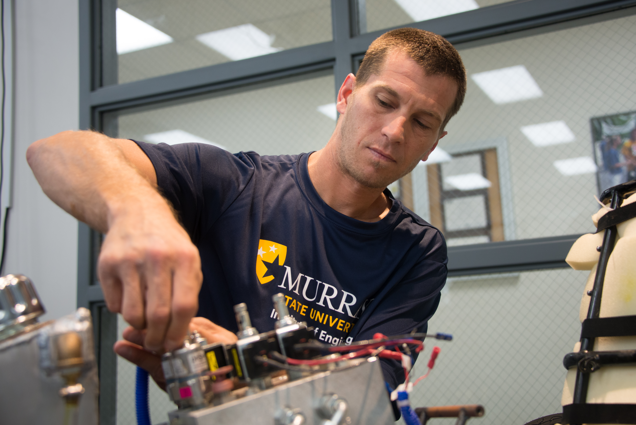
The importance of this academic program - Cyber issues today…
98% of web applications are vulnerable to attacks
66% of organizations expect their cyber security budget to grow
The cybersecurity market – $300 billion this year
60% of small businesses close after a cyber attack
70% of companies note a cybersecurity skills shortage
Source: Terranova Security

Slide 5
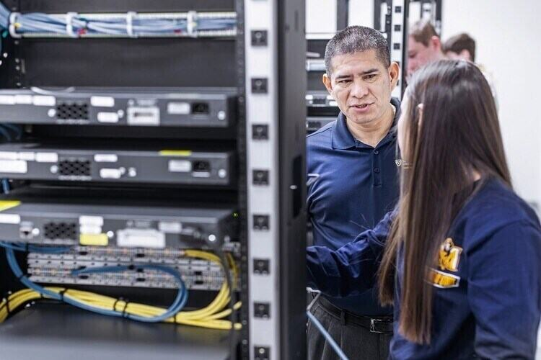
Record Enrollment – Fall 2023
Murray State University’s statewide Program of Distinction in Cybersecurity and Network Management has welcomed its largest freshman class in program history with a 30% increase in overall program enrollment from last fall.

Slide 6
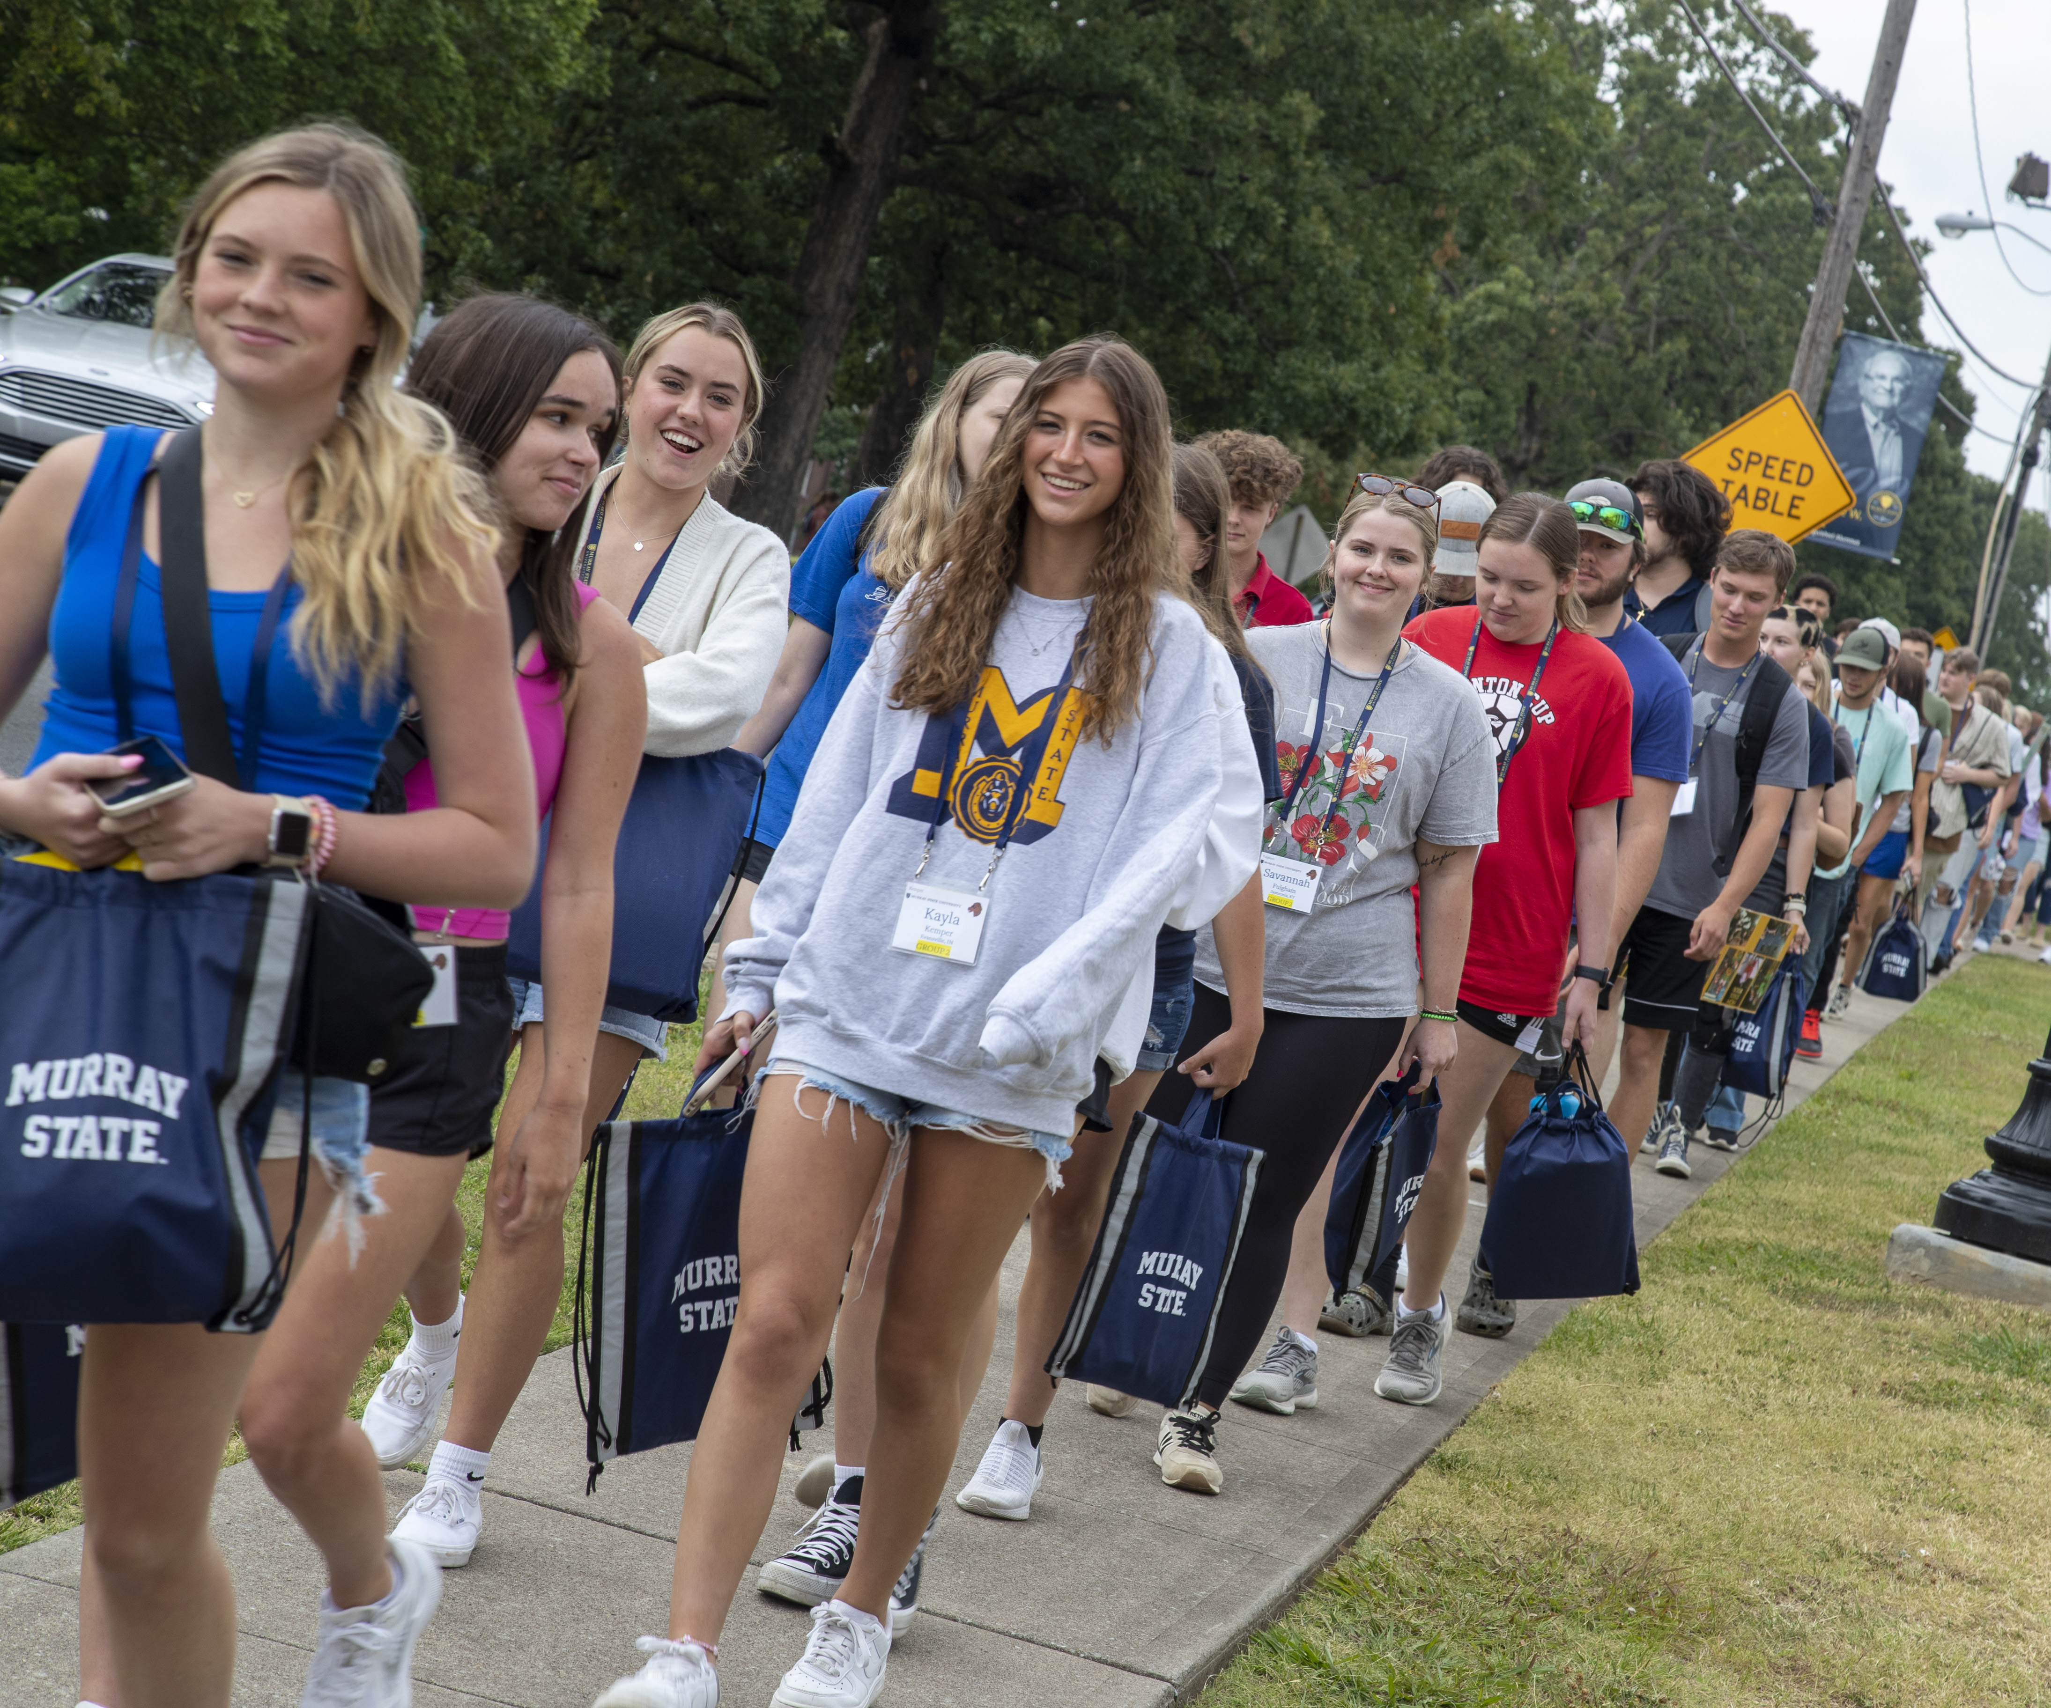
University Update Enrollment
Fall 2023…a Record Freshman Class
Largest total enrollment in six years
Spring 2024…largest since 2016

Slide 7
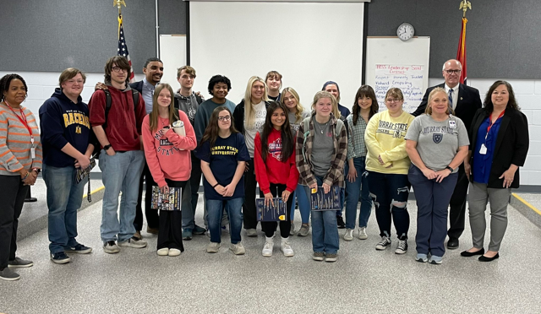

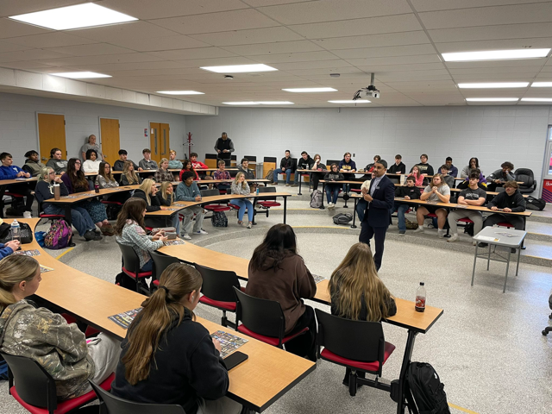
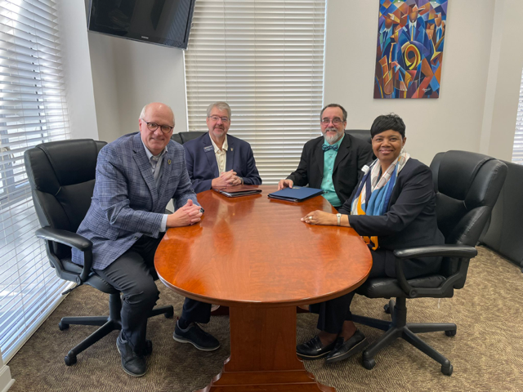
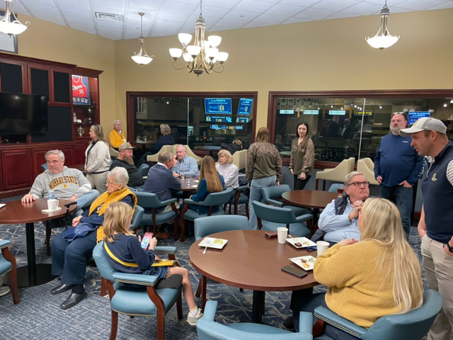
Recruiting

Slide 8
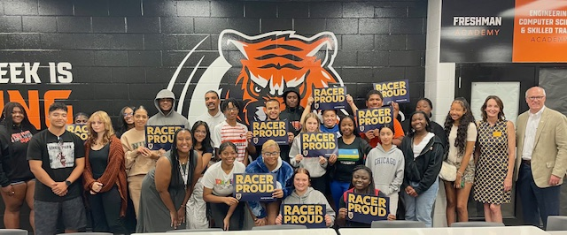
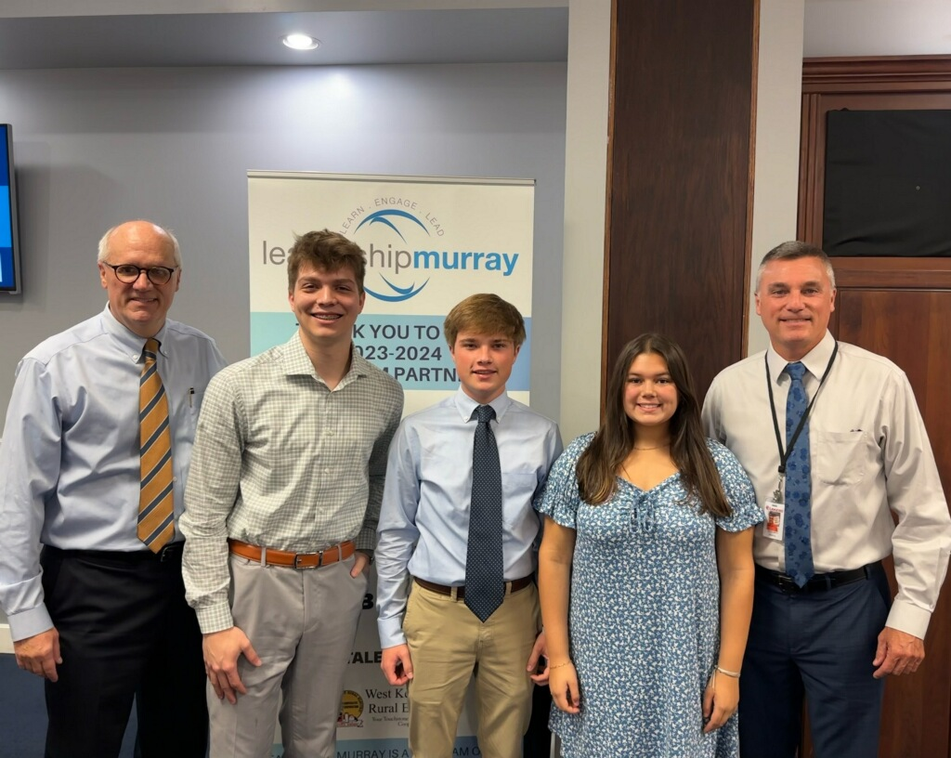
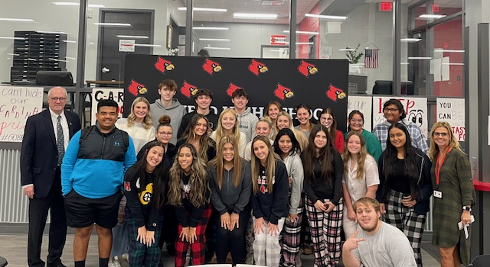
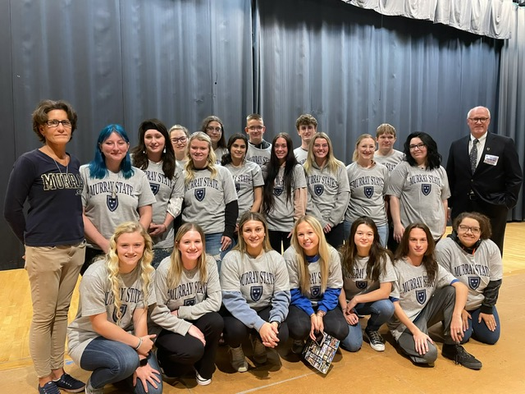
Recruiting

Slide 9
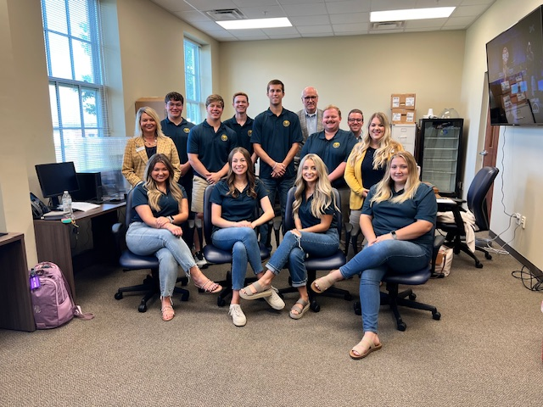

Centennial Campaign Be Bold: Forever Blue and Gold
$100 Million Campaign
Excellent Progress…$77 million
Bill Garrett Estate Gift
Naming/Legacy Opportunities
Thank you to our donors, alumni and friends…setting records.

Slide 10
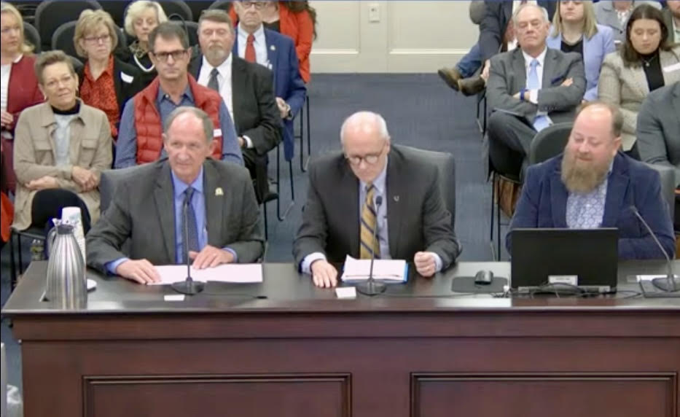
Legislative Session
Legislative Update
School of Nursing and Health Professions Building – $45.5M
Veterinary Sciences Building – $60M
Learning Commons/Residential Hall – $38M
Asset Preservation/Deferred Maintenance – $47M
Station 74/Murray State University
College Courts
Among many others
Numerous Renovations and
Campus Improvements

Slide 11
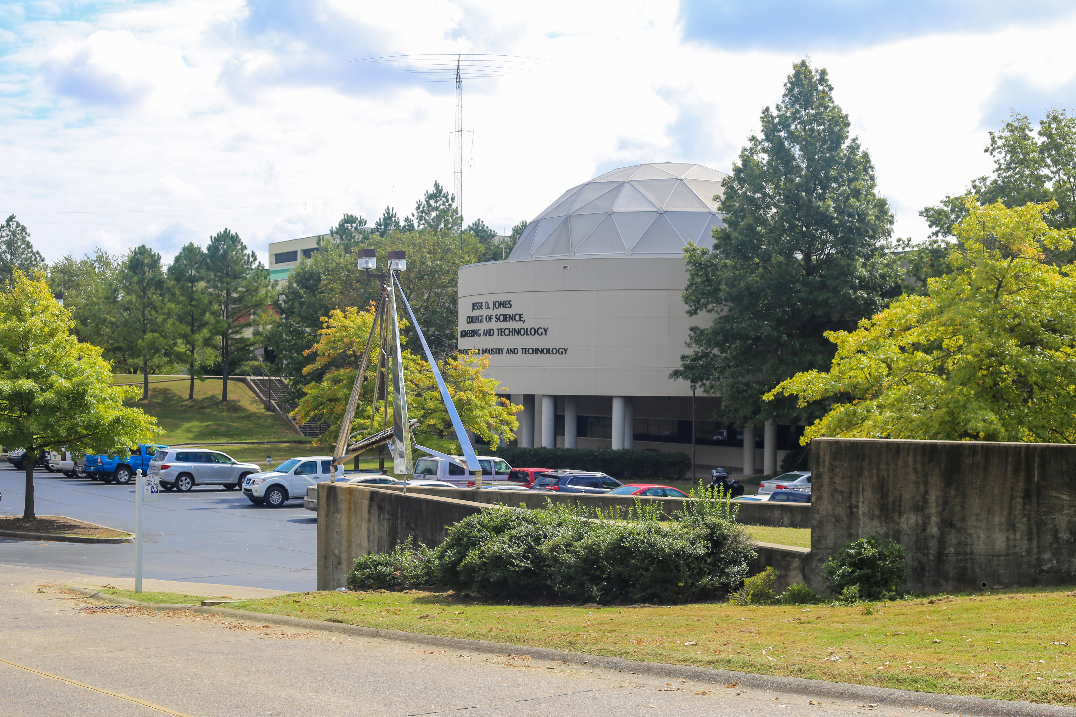
AND…
“$10,000,000 in fiscal year 2025-2026 to the Murray State University budget unit for construction, renovation, and operations for the University’s cybersecurity program.”
An era of university
transformation
Academic programs
New/enhanced facilities
Campus

Slide 12
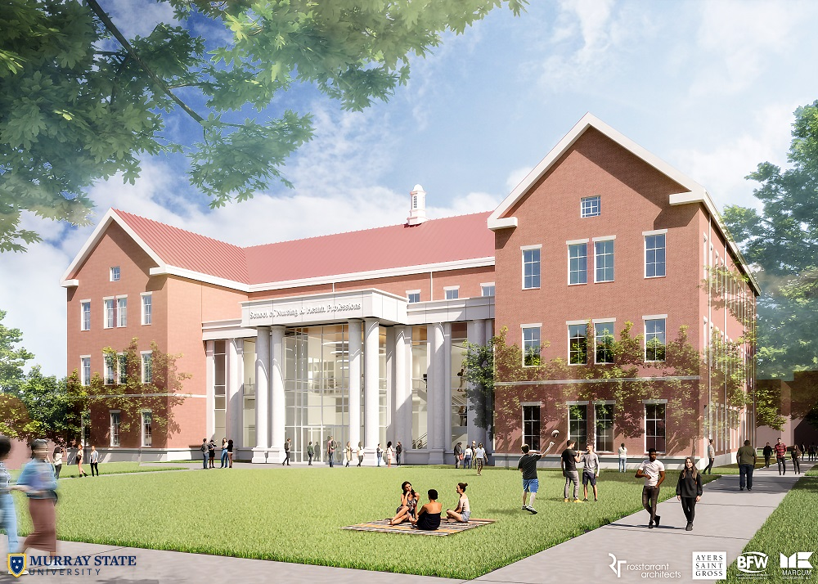
School of Nursing and Health Professions Building

Slide 13
Residential Housing Recruiting and Retention
Station 74 at Murray State University
College Courts

Slide 14
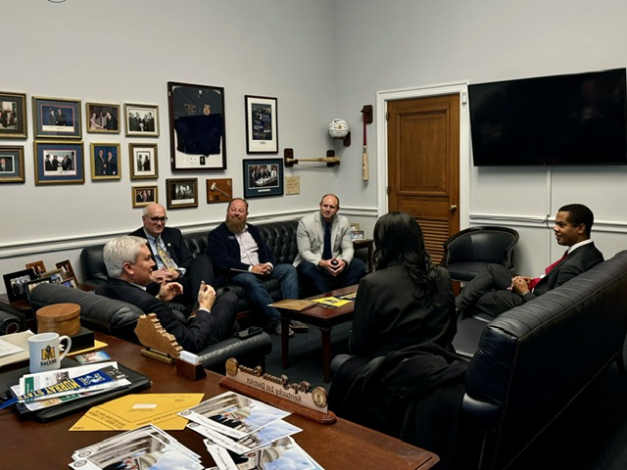
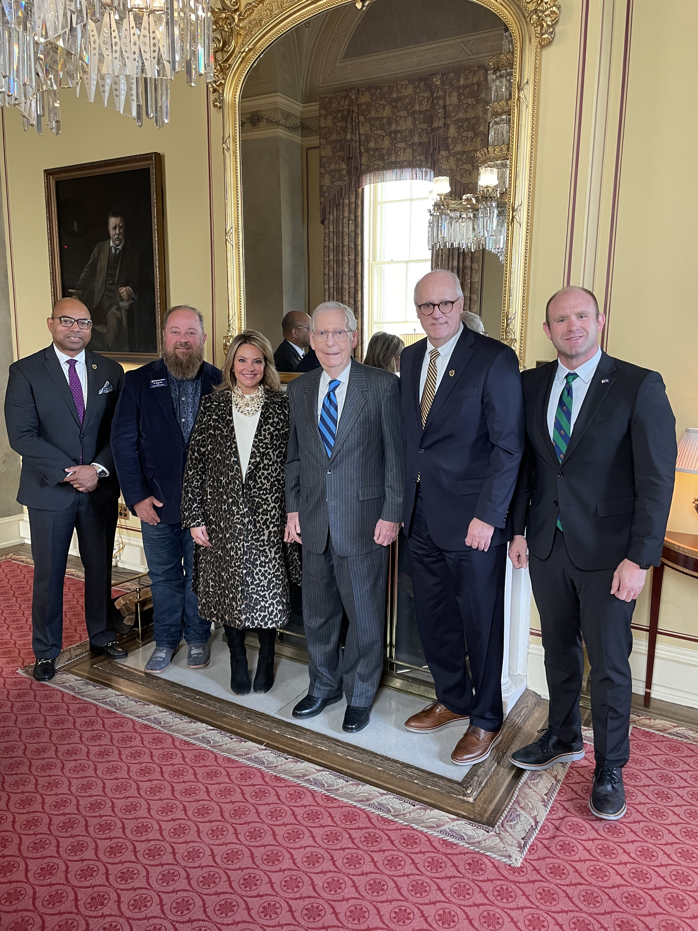
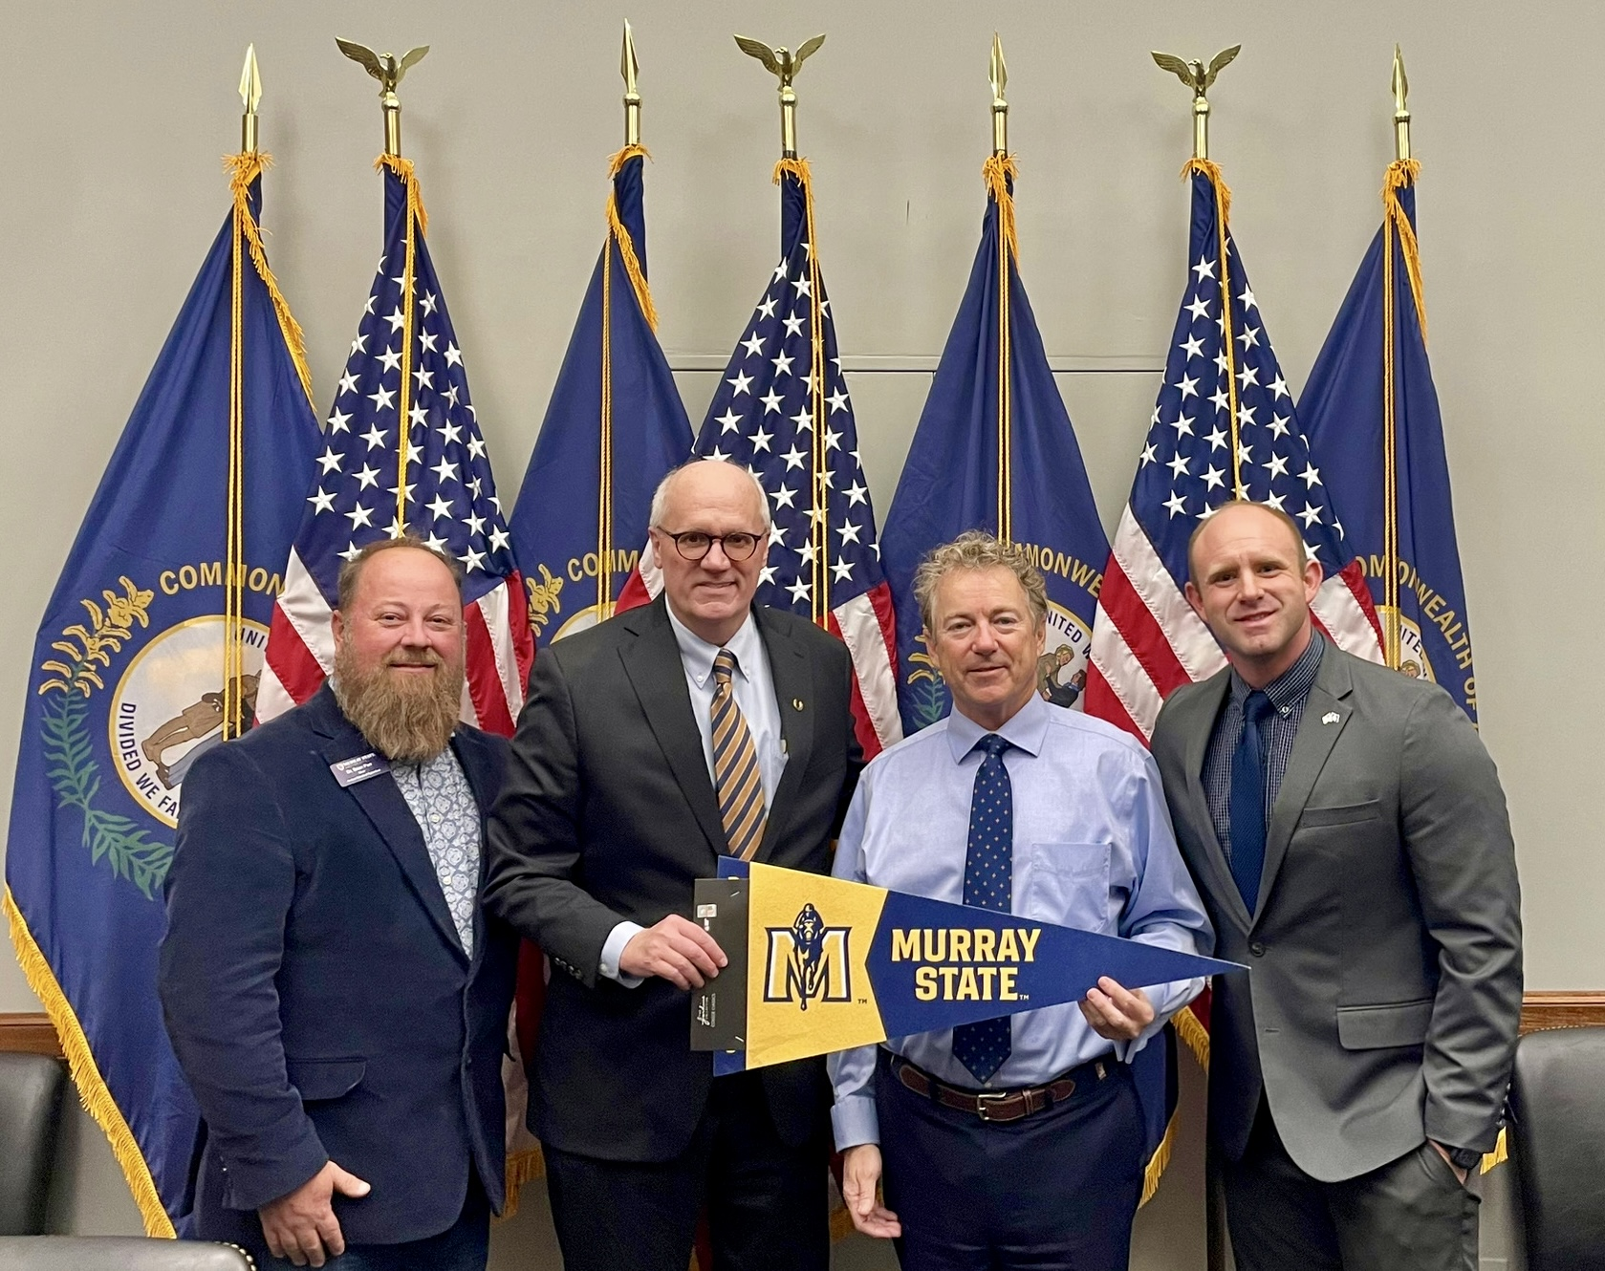
Washington, DC Meetings
Capitol Hill Visits
Grants/Appropriations
$1.1 Million
MSU Police Department

Slide 15
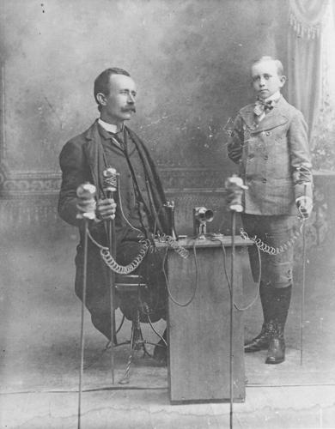
Questions?
Murray Ledger and Times

