Slide 1
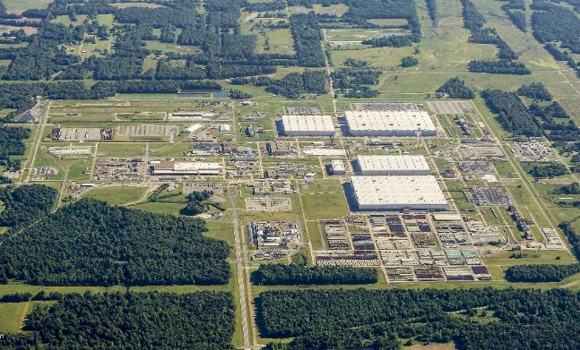
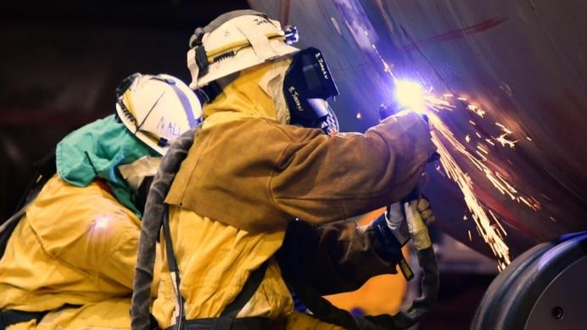
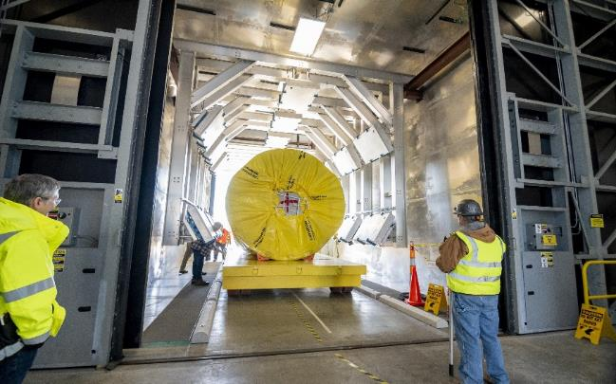
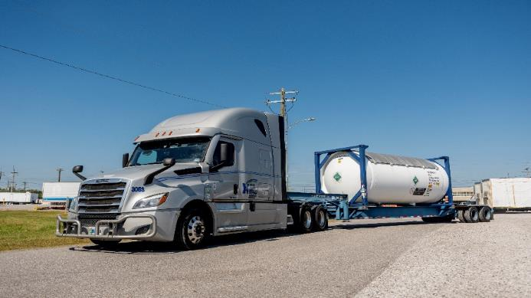
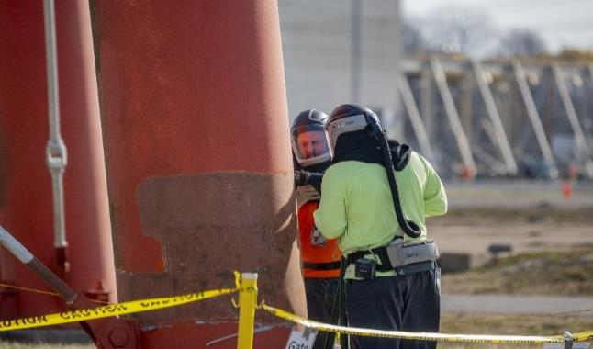
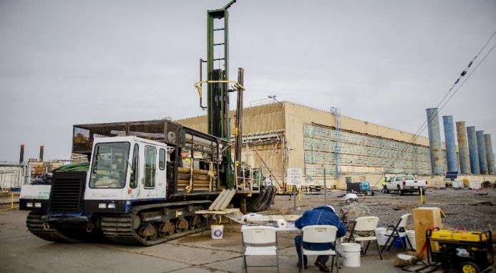
Paducah Site Overview
PORTSMOUTH PADUCAH
PROJECT OFFICE

Slide 2
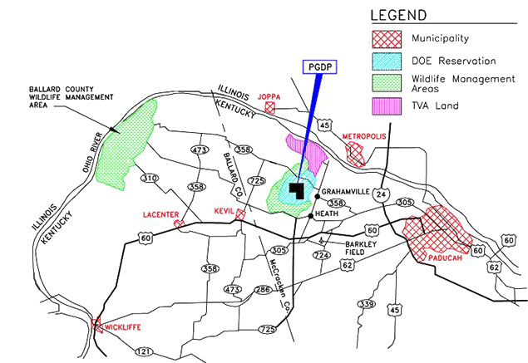
Paducah Gaseous Diffusion Plant

Slide 3
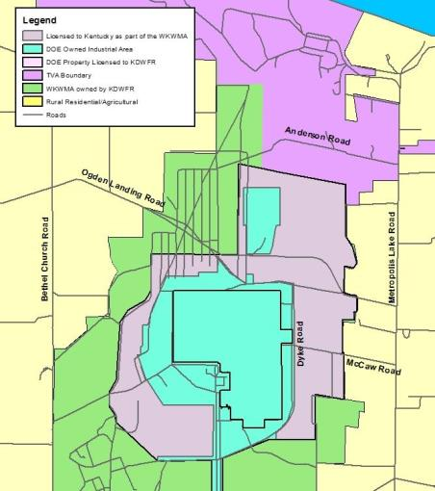
Land Ownership
Site originally was Kentucky Ordnance Works (KOW), a World War II munitions plant.
In 1950, the Atomic Energy Commission picked KOW site for the second of three planned uranium enrichment plants.
In 1952 the plant began operations as a government-owned, contractor-operated facility under DOE oversight.
In 1992 USEC was established as a government corporation to take over operation of Paducah and Portsmouth.
DOE assumed control of plant in 2014.
DOE-owned land consists of 3,556 acres with license agreements for
  West Kentucky Wildlife Management Area (WKWMA).

Slide 4
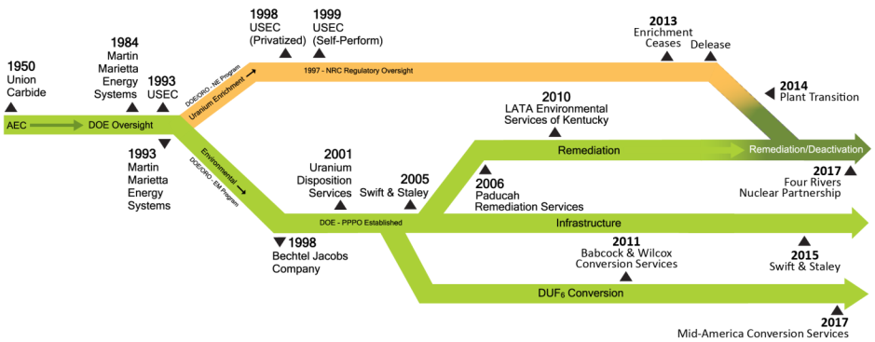
Contracting History

Slide 5
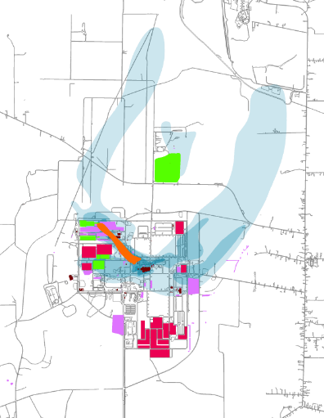
Cleanup Scope Integration
Long-term facilities removal
> 500 structures with a footprint of nearly 200 acres to be removed
Underlying soils to be investigated; cleaned up as needed
Burial grounds
10 burial grounds, ~100 acres
Some contain radioactive, pyrophoric, and RCRA waste
Major TCE source
Primary source of off-site contamination
Heavy concentrations present; >500,000 ppb of TCE in groundwater
Surface Water
Remediation of ~8 miles contaminated creeks, ditches, etc.
Deactivation
Infrastructure optimization (e.g., switchyard consolidation)
Facility modifications incl. repairs for ~3mil ft² of roofs
Deactivation activities incl. oils and refrigerant removal from process buildings
Uranium deposit removal from process buildings
Inactive facilities
Demolished 174 facilities, trailers and structures totaling more than 550,000 square-feet
Tc-99 plume
Radionuclide releases have migrated off-site, but not above Drinking Water Standards.
Contaminated soils
PCBs and uranium
63 areas totaling ~100 acres
Depleted uranium
About 46,000 cylinders

Slide 6
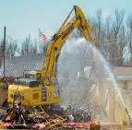
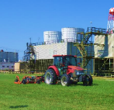
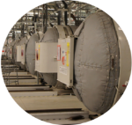
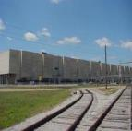
Paducah Site Contractors
Four Rivers Nuclear Partnership
Deactivation
Remediation
Stabilization
Optimization
Contract value is ~1.7B
5-year contract w/two option periods from July 2017 to June 2027
Current employment is ~970 employees
Swift & Staley Inc.
Infrastructure (facility; road & grounds; rail, etc.)
Safeguards & Security
Records management
Property and fleet management
Information technology & Cyber Security
Contract value $427M
5-year contract from December 2015 through September 2020; extended through May 2025
~175 employees
Mid-America
Conversion Services
DUF6 plant construction
DUF6 plant operation
Cylinder management
5-year contract from February 2017 to February 2021
Extended through May 2025
Contract value ~$923 million (Total)
~230 employees (Paducah)
Enterprise Technical
Assistance Services
Oversight support to site office
Environmental technical services
Project/program management support
3-year base contract with a two-year option from April 2020 through March 2025
Contract value ~$30 million (Paducah)
~50 employees (Paducah)

Slide 7
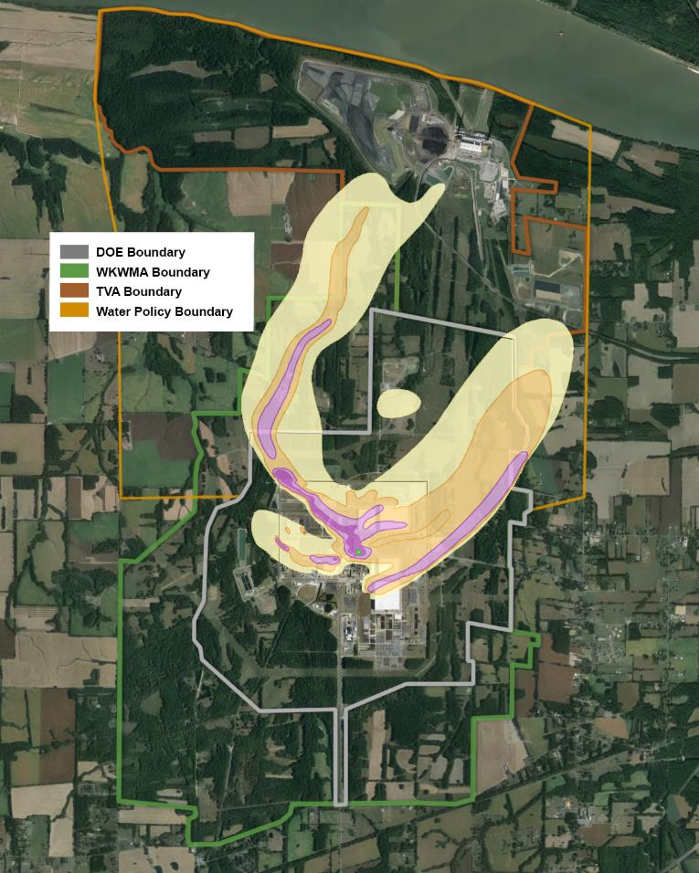
Off-Site Contamination Discovered
1998 Contaminated Groundwater Plume
Like many plants operating over 60 years, plant operations resulted in soil, groundwater, and surface water contamination.
In 1988, TCE (trichloroethene), a common cleaning solvent, was discovered contaminating some neighbor’s residential wells.
Municipal water lines extended into affected homes.

Slide 8
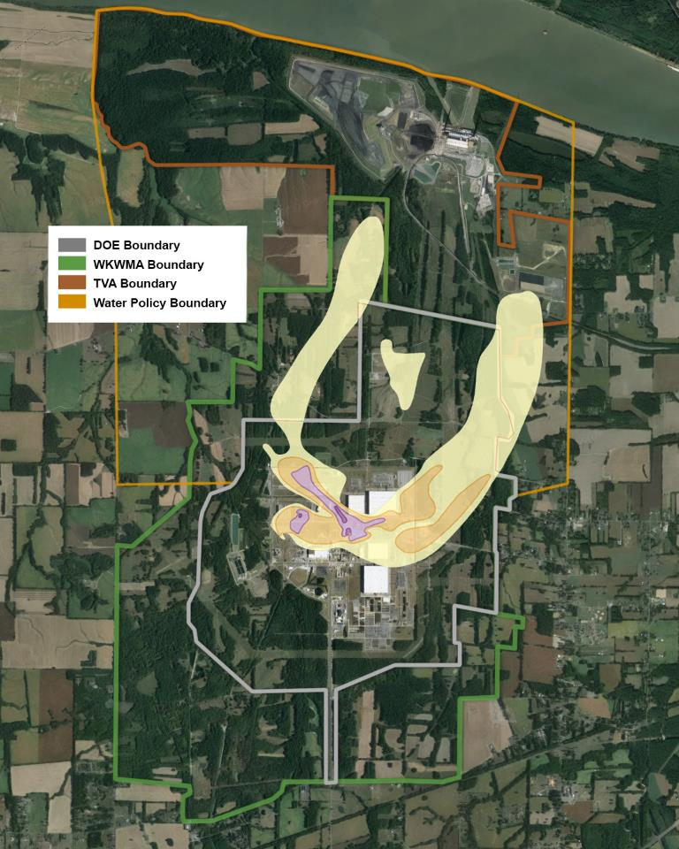
Groundwater Cleanup
Since mid-1990s, two pump-and-treat systems have reduced off-site migration and concentrations of TCE.
  >5.1 billion gal of groundwater treated.
Northwest Plume Pump-and-Treat optimization project (new wells) installed in 2010 has dramatically increased capture of high-concentration TCE plume.
Phase I of the Northeast plume Pump-and-Treat optimization began in 2016 to improve TCE removal. Phase II was completed in the fall of 2017.
2022 Contaminated Groundwater Plume

Slide 9
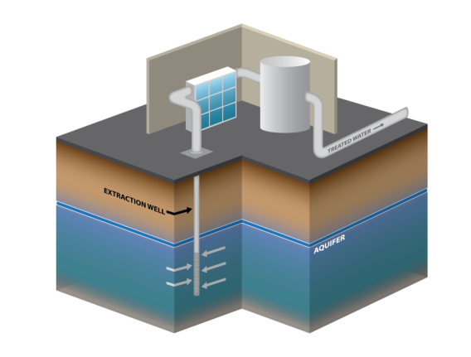
Groundwater Pump & Treat

Slide 10
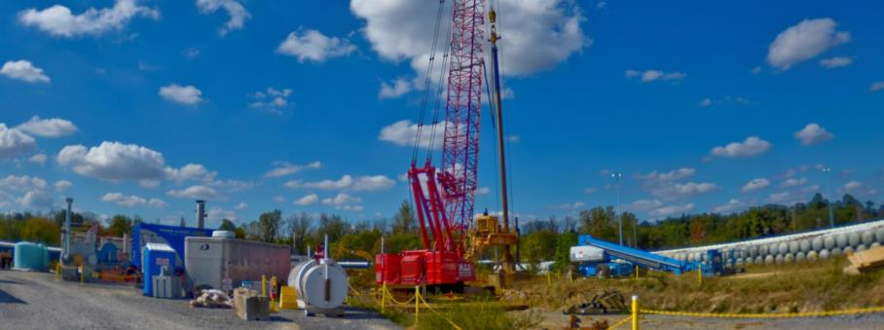
Groundwater Southwest Plume
A 200-ton, 150-ft-high crawler crane was used for deep soil mixing operations
2.2-acre landfarm in southwest part of Paducah plant used in 1970s to biodegrade waste oils.
TCE contamination in ground was key source of on-site groundwater contamination.
Deep soil mixing was employed to remove TCE in area known as SWMU 1.
8 ft.-diameter augers injected reactive iron to mix with soil to a depth of about 60 ft. More than 250 borings were completed.

Slide 11
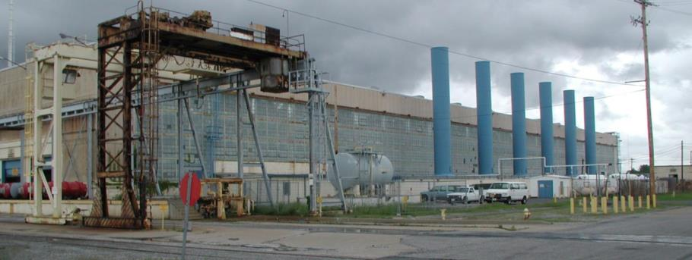
EM History – Significant Events
C-400 degreasing operations uses TCE as a primary cleaning solvent
1952—1960
Plant operations began, requiring various support facilities such as electrical switchyards and a chemical cleaning/decontamination building (C-400), waste water treatment facilities, etc.
Work for Others introduces contaminants that normally would not result from uranium enrichment
C-340 Complex was used to convert DUF6 to HF and UF4 and UF4 to uranium metal; closed when need for HF could be met by commercial facilities.

Slide 12
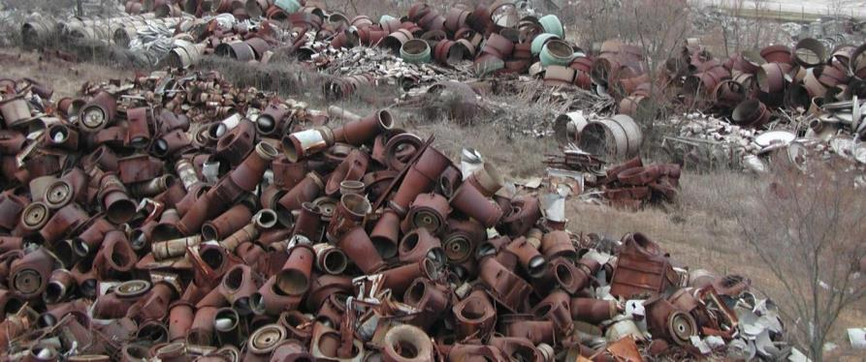
EM History – Significant Events
1970s-1980s
Upgrade of plant process equipment resulted in thousands of tons of equipment being removed to the northwest corner of the plant.
C-410/420 complex shut down after it no longer was needed to manufacture feed stock
Waste oils contaminated with uranium, polychlorinatedbiphenyls (PCBs), and solvents routinely
land farmed to test viability of biodegradation as a treatment option.

Slide 13
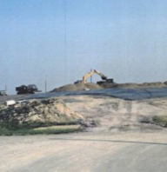
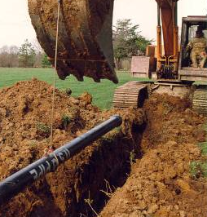
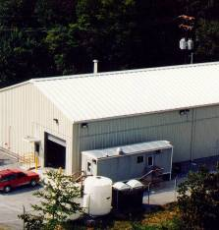
EM History – Significant Events
C-404 being closed
Extending municipal water line
Pump and Treat Facility
1980s—1990s
Discovery of high PCB levels (> 1,000 ppm) in Outfall Ditch 011 leads to cleanup action—approximately 1,300 drums of contaminated sediment removed.
Discovery of RCRA-hazardous (Resource Conservation and Recovery Act) waste resulted in closure/capping of the C-404 Burial Ground, the primary disposal area for Low-Level Waste.
Contamination found in residential wells; municipal water lines extended and environmental remediation program begins.
Entered into CERCLA (Comprehensive Environmental Response, Compensation, and Liability Act) Administrative Consent Order with EPA.

Slide 14
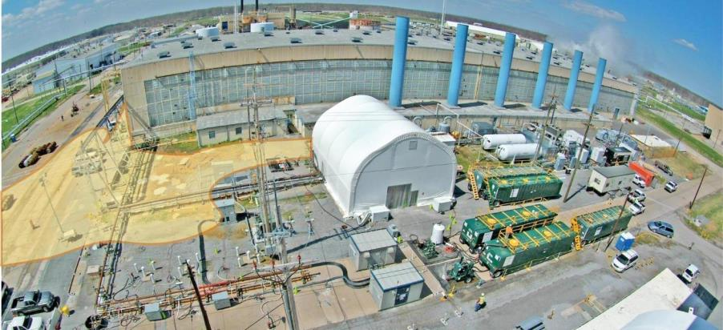
EM History – Significant Events
Present C-400 Source Remediation
1986
During repairs to a storm sewer at the southeast corner of C-400, workers discovered evidence that the degreaser trichloroethene (TCE), for an undetermined number of years, had been flowing directly into the sewer; investigation showed the chemical was overflowing from an improperly designed sump pump.

Slide 15
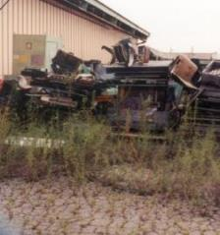
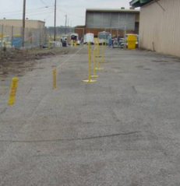
EM History – Significant Events
2000s—2010s
Completed key treatability study demonstrating effectiveness of electrical resistance heating (ERH) at C-400 area.
Initiated accelerated actions to D&D several inactive facilities.
Site Management Plan (SMP) approved by EPA and Kentucky in 2004, constituting the first approved SMP since 1999.
DMSA Before
DMSA After

Slide 16
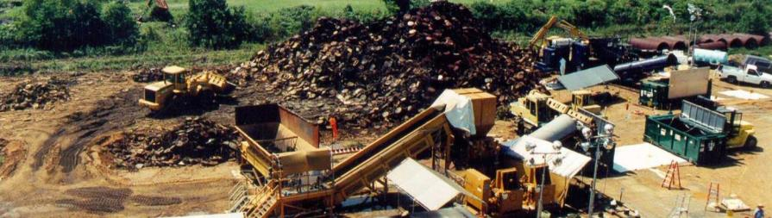
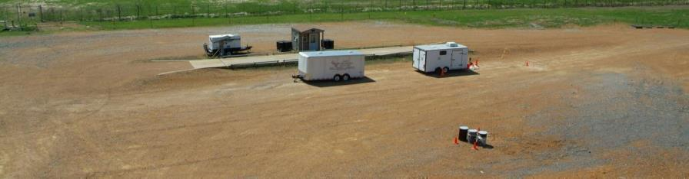
EM History – Significant Events
Drum Mountain Removed 2000
BEFORE
AFTER

Slide 17
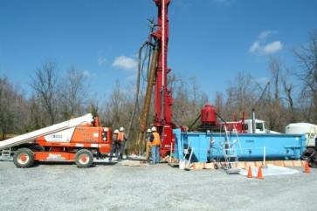
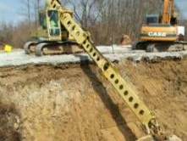
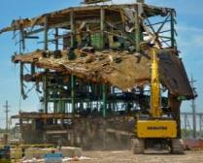
EM History – Significant Events
2010—2015
Groundwater modeling and two new extraction wells in 2010 increased TCE capture in the Northwest Plume to nearly 100%.
Completed removal of over 22,000 yds3 of contaminated sediment.
Demolition of C-746-A East End Smelter, C-340 Metals Plant and C-410 Feed Plant completed totaling nearly 300,00 ft2.
Paducah Gaseous Diffusion Plant facilities returned to DOE for deactivation and cleanup.
Sediment Removal
Demolition of C-410

Slide 18
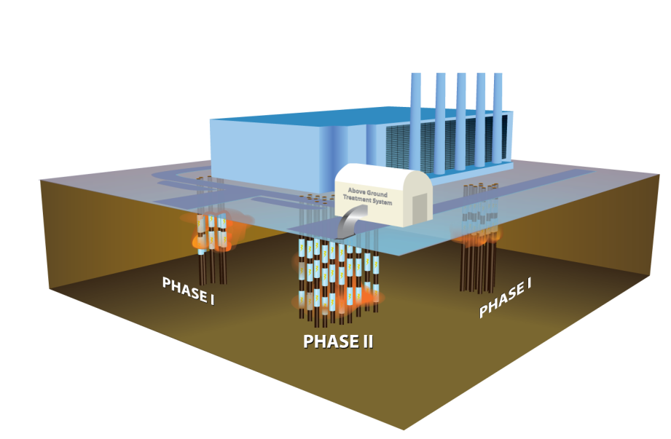
EM History – Significant Events
Began operation for C-400 TCE Source Removal Action, ERH, to remove TCE from below ground near cleaning building.

Slide 19
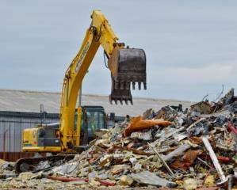
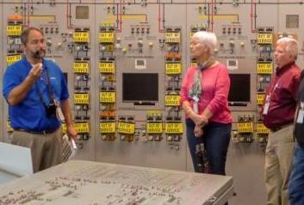
EM History – Significant Events
Removal of C-746-B debris
Public tours in the C-300 Control Building
2016
Replaced 3.2 million square feet of roofing to address leaks in facilities Plant returned with significant maintenance/repair backlogs.
11 inactive facilities, more than 100,000 ft2, were demolished beginning in 2016.
Expanded community outreach by offering tours of the site to the public.
Transferred nearly 10,000 tons of excess coal to the Paducah Area Community Reuse Organization (PACRO) for revenue for economic development in the area.

Slide 20
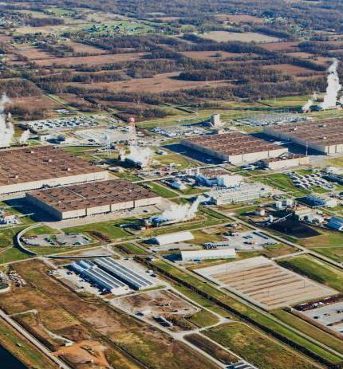
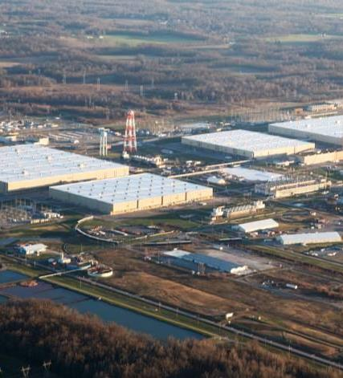
EM History – Significant Events
Before
After

Slide 21
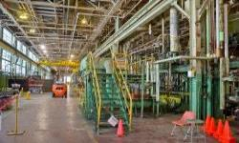
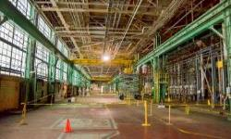
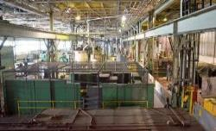
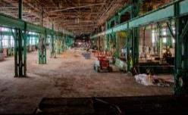
EM History – Significant Events
2017
In the fall of 2017 DOE and regulators reached an agreement that accelerated remediation of the C-400 Cleaning Building.
Accelerated deactivation of the C-400 Cleaning Building clearing over 82,000ft² of floor space.
Work was completed on the optimization of the Northeast Plume Pump-and-Treat system including the installation of two new extraction wells, fourteen monitoring wells, eight wells to measure water levels, and a new treatment unit.
Before
After
Before
After

Slide 22
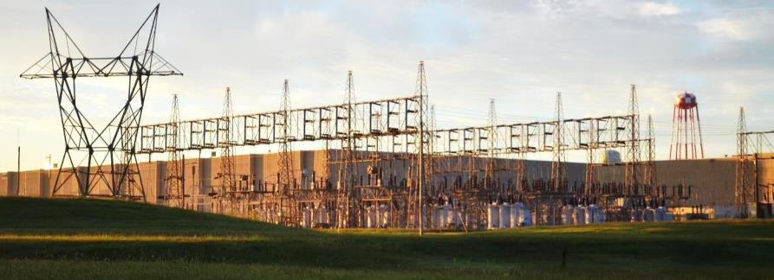
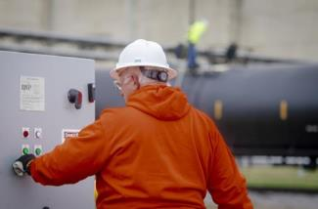
EM History – Significant Events
2018
Deactivated C-533, C-535 and C-537 switchyards to reduce maintenance & right-size utilities.
Dispositioned ~ 800,000 gallons of transformer oil.
Fire systems were deactivated and the C-360 Toll, Transfer and Sampling facility configured for long term minimal surveillance and maintenance.

Slide 23
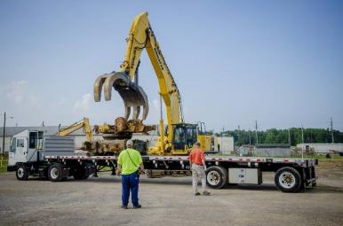
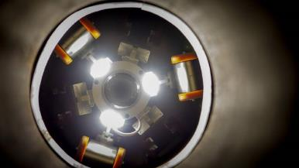
EM History – Significant Events
2019
Removed 60,000 ft3 of waste from the C-740 material yard.
Demolition of interim remedial action equipment to clear the way for the C-400 remedial investigation/feasibility study.
Transitioned all Criticality Accident Alarm System horns from air-supplied to electric, reducing the maintenance costs for the plant air system.
Completed the expansion of two additional cells at the C-746-U landfill.
Began testing a pipe-crawling robot and a converter measurement system in support of non-destructive assay characterization of progress gas equipment for deactivation of process buildings.

Slide 24
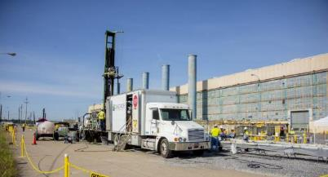
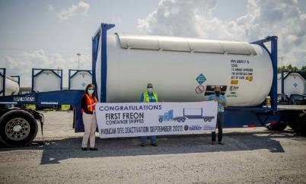
EM History – Significant Events
2020
Began utility isolations of high pressure fire water sprinkler systems in the C-333 Process Building in support of deactivation.
Initiated offsite shipment of uranium enrichment equipment including 22 “cold-traps” and 1 compressor.
Shipped the first container of R-114 Freon, ozone depleting refrigerant, reducing hazards at the site.
Marked 25 years of pump-and-treat operations to reduce the offsite migration of the groundwater plumes.

Slide 25
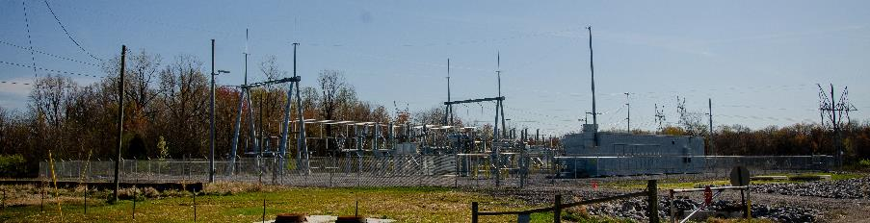
EM History – Significant Events
2021
Completed construction of new substation to deactivate the last of the site’s four switchyards.
Completed cleanout of 130,000 ft2 of stores and receiving from the C-720 Maintenance and Storage Building, reducing utility costs.
Completed cleanout of C-720-C to support Material Sizing Operations in deactivation of the C-333 Process Building.
Completed characterization of C-535 and C-537 switchyards in support of future dismantlement.
Transferred 210,000 gallons of insulating oil from the plant‘s switchyards to the Paducah Area Community Reuse Organization.

Slide 26
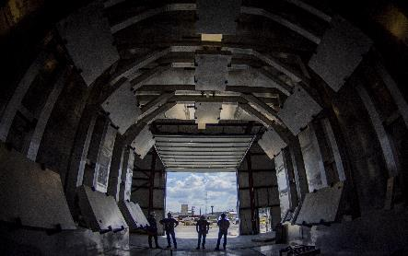
EM History – Significant Events
2022
Completed construction of the Large Item Neutron Assay System—also known as LINAS, a first of it’s kind facility to scan for deposits in process gas equipment.
Began removal of process gas equipment and clearing a football field sized footprint in the C-333 Process Building for construction of a Material Sizing Area (MSA) to support future demolition.
LINAS scanning chamber

Slide 27
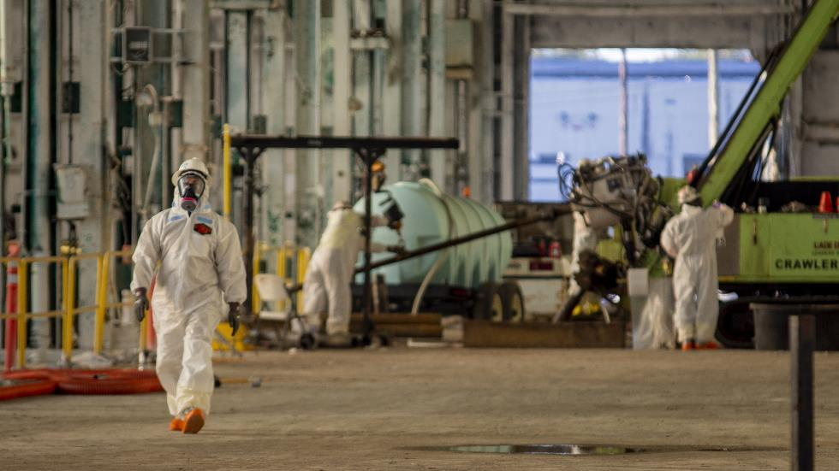
EM History – Significant Events
2022
Completed largest environmental investigation at the Paducah Site at the C-400 Complex since the Federal Facilities Agreement was signed in 1998.
Completed Bioremediation remedial action fieldwork for the Southwest Plume ahead of schedule.
Drilling in C-400

Slide 28
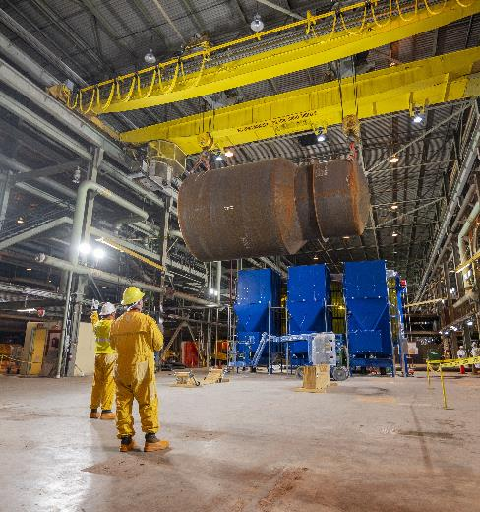
EM History – Significant Events
2023
Completed construction of two segmentation shops the in C-333 Process Building Material Sizing Area and began converter segmentation.
Installed equipment for process gas equipment size reduction.
Completed commissioning of LINAS to scan process gas equipment taken out of the
C-333 Process Building.
Began process to streamline regulatory strategy with KY and EPA.

Slide 29
Decision 2029
Decision Document
Decision Document
Decision Document
Decision Document
Decision Document
Decision Document
Decision Document
Decision Document
Decision Document
Decision Document
Decision Document
Decision Document
Decision Document
Decision Document
Decision Document
Decision Document
Decision Document
Decision Document
Decision Document
Decision Document
Decision Document
Decision Document
Decision Document
Decision Document
Decision Document
Decision Document
Decision Document
Decision Document
Decision Document
Decision Document
Decision 2029 Goal
Establish a streamlined regulatory framework focused on a comprehensive site wide cleanup for PGDP that facilitates a reindustrialization end-state attractive to industry.
Decision Document
Decision Document
Decision Document
Decision Document
Decision Document
Decision Document
Decision Document
Decision Document
Decision Document
Decision Document
Decision Document
Decision Document
Decision Document
Decision Document
Decision Document
Decision Document
Decision Document
Decision Document
Decision Document
Decision Document
Decision Document
Decision Document
Decision Document
Decision Document
Decision Document
Decision Document
Decision Document
Decision Document
Decision Document
Decision Document
Decision Document
Decision Document
Decision Document
Record of Decision
Sitewide D&D
Record of Decision
Waste Disposal Alternative
Record of Decision
Environmental Media
Decision 2029 will integrate the multitude of current decision documents into a consolidated set of FIVE distinct decisions focusing on THREE
Notes:
Decision 2029 will integrate the multitude of current decision documents into a consolidated set of FIVE distinct decisions focusing on THREE:
Sitewide D&D
Waste Disposition Alternative
Environmental Media
Plus…
C-400 (in progress)
Comprehensive Site Operable Unit

Slide 30

Waste Disposal Alternatives
Approximately 3.6 million cubic yards of waste is expected to be generated from the demolition of over 500 buildings and facilities and continued environmental remediation of the Paducah Site.
The existing plant industrial landfill will be used to maximum capacity (~1 million cubic yards).
Options for the remaining 3 million cubic yards of waste are being evaluated in a Remedial Investigation/Feasibility Study.

Slide 31

Reindustrialization of the Site
DOE awarded a $2 million non-competitive financial assistance grant to lead a study for the future of PGDP to the Paducah Area Chamber of Commerce. This project will consist of site mapping, community studies, data analyses, and development of recommended strategies. The grant will be administered over a 3-year period through December 31, 2025.

Slide 32

Reindustrialization of the Site
The Paducah-McCracken County Industrial Development Authority PACRO requested land from the Paducah Site to be transferred back to the community.
The transfer request was to acquire a 250-acre parcel of land, a crucial step toward the future reindustrialization of the site.

Slide 33

Murray State University Grant
In 2024, DOE awarded a grant to Murray State University for $1.5 million over a 5-year period.
The purpose of the grant is to assist with community engagement regarding reuse of the Paducah Site and associated activities.

