Slide 1
MSU DOE GRANT
Presentation on Portsmouth Gaseous Diffusion Plant (PORTS)
By
Sampson Opoku

Slide 2
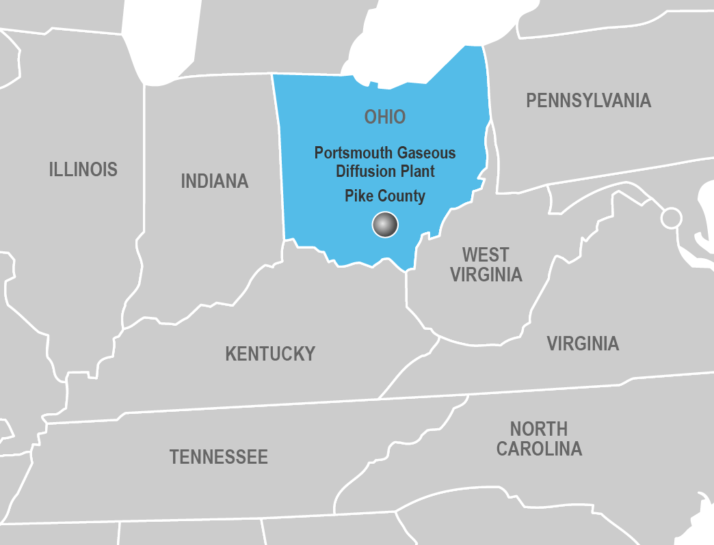
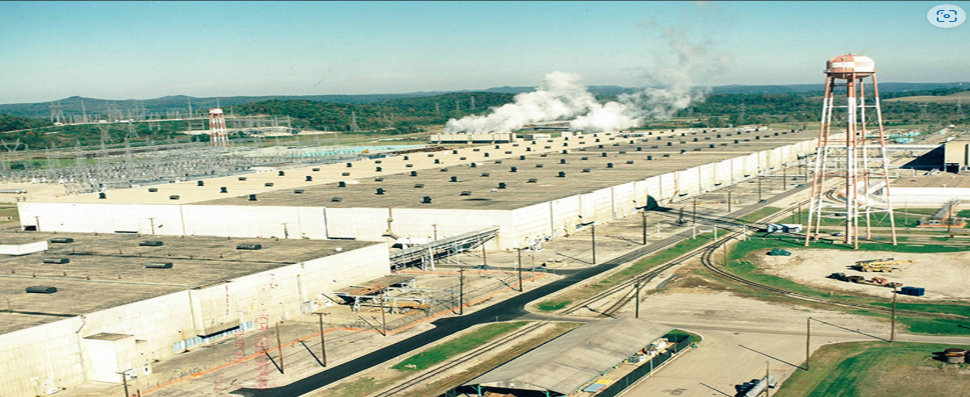
Study Area
OHIO
Portsmouth Gaseous Diffusion Plant (PORTS)

Slide 3
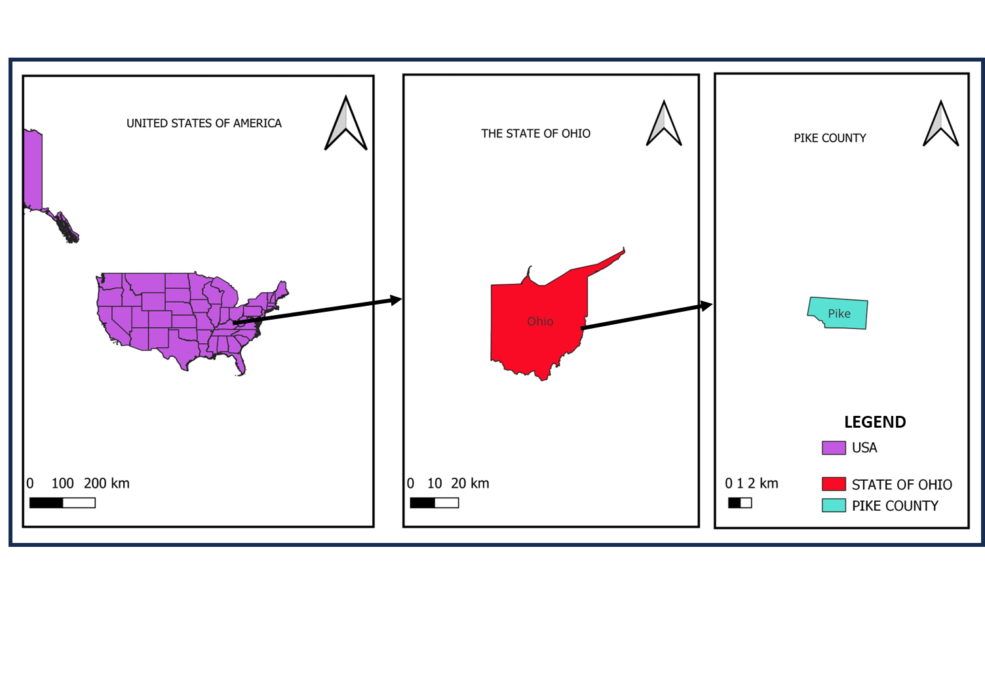
Study Area

Slide 4
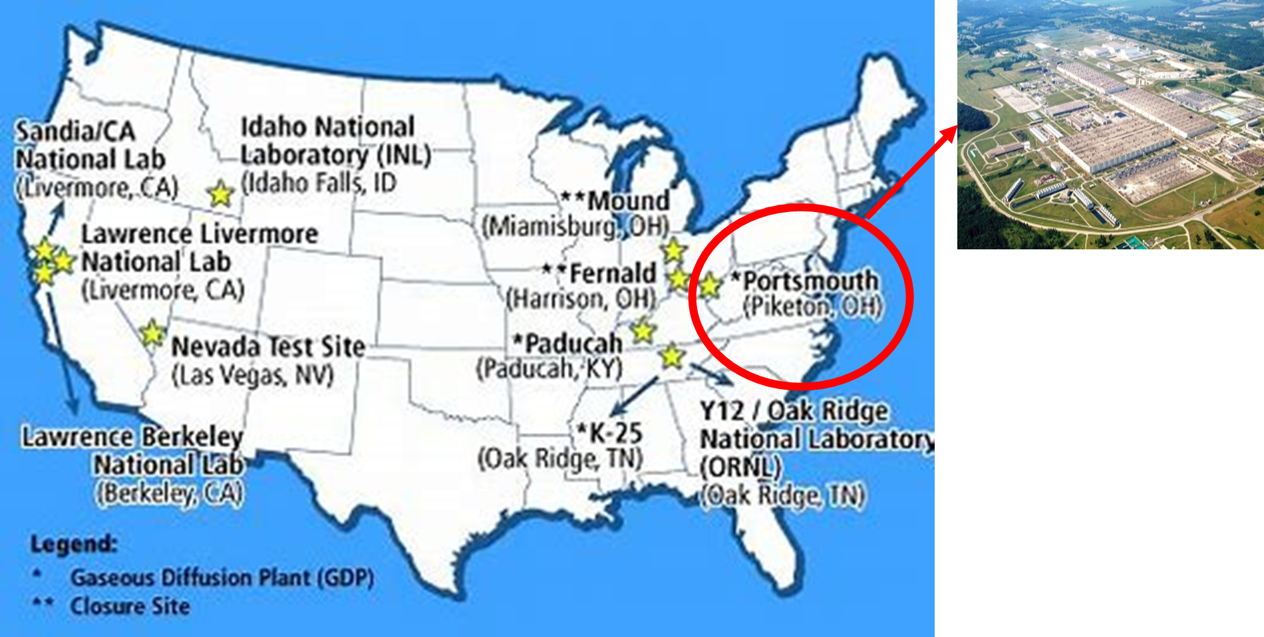
Overview of Gaseous Diffusion Technology:
Process used to enrich uranium for nuclear power and weapons.
Role in Cold War nuclear weapons production.

Slide 5
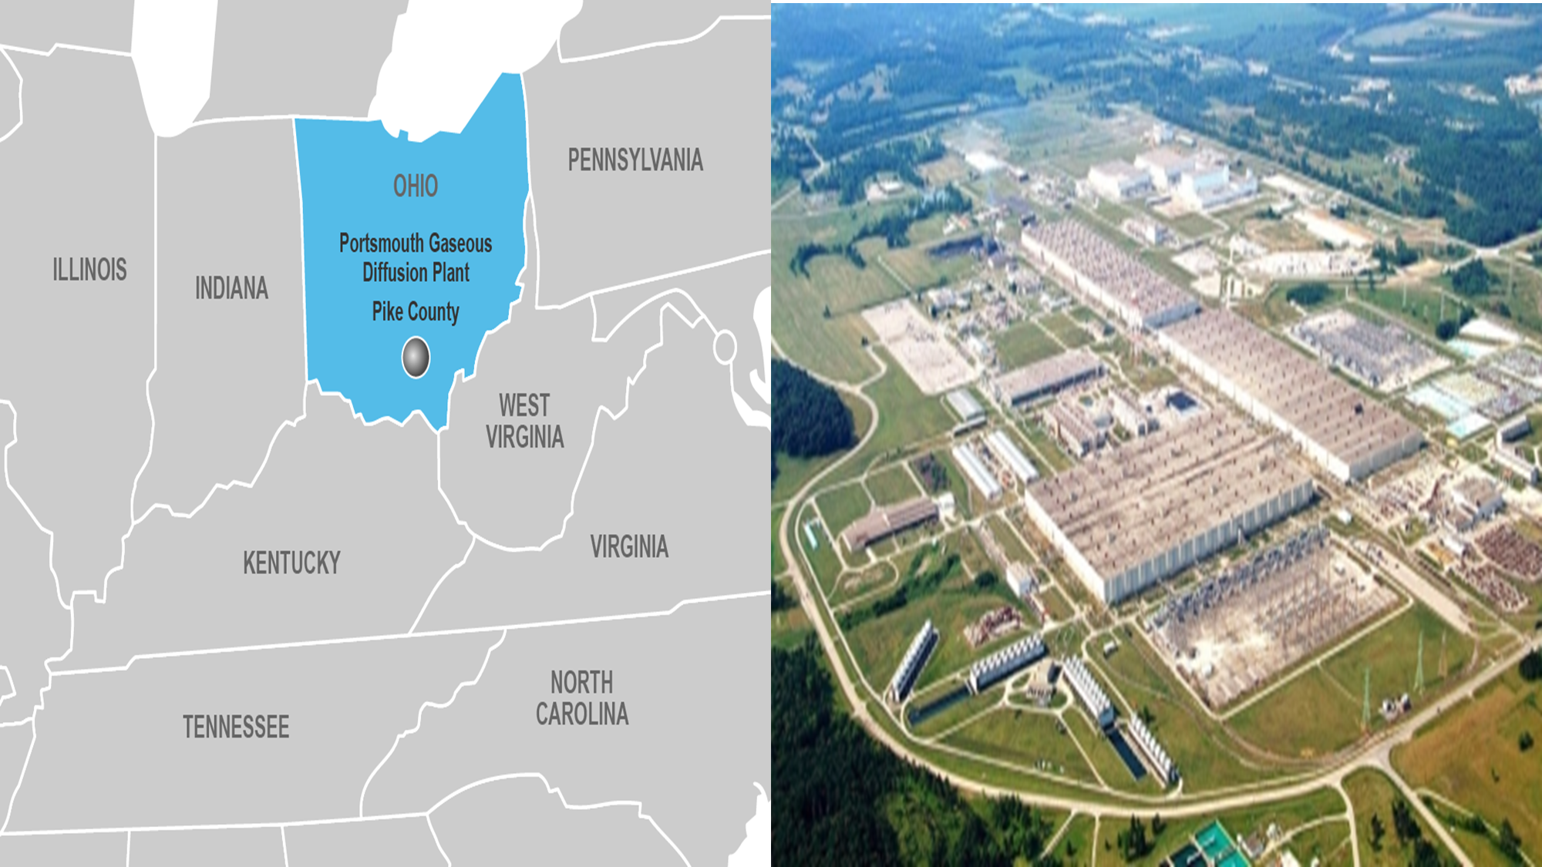
Site Features
Main Process Buildings: The three massive process buildings (X-333, X-330, and X-326) housed the gaseous diffusion cascades.
Support Facilities: In addition to the process buildings, there were several support facilities, including cooling towers, maintenance shops, and laboratories.
Waste Management Areas: There are areas on-site dedicated to waste management, where radioactive and hazardous materials from plant operations are stored.

Slide 6
Portsmouth Gaseous Diffusion Plant
Location: Pike County, Ohio
History:
Built in the early 1950s during the Cold War.
Operated from 1954 to 2001.
Initially enriched uranium for nuclear weapons, later for nuclear power.
Operations:
One of three US gaseous diffusion plants.
Transitioned to decommissioning and environmental remediation after closing.
Current Status: Ongoing decontamination and decommissioning activities.

Slide 7
Benefits of the Plant to the Community
The Portsmouth Gaseous Diffusion Plant (PORTS) provided significant benefits to the surrounding community during its operational years and continues to offer potential advantages through its ongoing redevelopment efforts:

Slide 8

Job Creation: At its peak, PORTS employed thousands of workers, providing stable, well-paying jobs that supported families and bolstered the local economy.
Economic Growth: The plant's presence spurred development in the region, with businesses and services thriving as a result of the economic activity generated by PORTS employees.

Slide 9

Community Infrastructure: With a large workforce and investment in local facilities, PORTS indirectly helped improve infrastructure such as roads, housing, and public services in the region.
Technological Advancement: The plant introduced advanced technologies and industrial practices to the area, fostering a skilled labor force and contributing to regional innovation.

Slide 10

Environmental and Economic Redevelopment: After its closure, ongoing environmental cleanup and repurposing efforts aim to transform the site into a hub for new industries, potentially bringing new jobs and investments back to the area.
Long-term Legacy: PORTS has left a lasting legacy of resilience and industrial significance, with current efforts focused on ensuring the site remains an asset to the community through future economic opportunities.

Slide 11
How Can The Community Make Use Of The Site
The community around the Portsmouth Gaseous Diffusion Plant (PORTS) can make use of the site in several ways, turning it into a source of economic revitalization, environmental sustainability, and community development. Here are a few key ideas:

Slide 12

Industrial and Commercial Development
Attract New Businesses: It provides a vast area already developed, easily convertible for any new industry ranging from manufacturing to technology firms. Local leaders can attract businesses by marketing the site's unique assets.
Logistics/Warehousing: The site, with its size and infrastructural setup, could be transformed into a hub for warehousing, distribution, and logistics, creating steady employment opportunities.

Slide 13

Renewable Energy Projects
Solar or Wind Energy Farms: Portions of the estate could be used for renewable energy projects, like solar or wind farms, creating jobs and contributing to a sustainable, eco-friendly future.
Clean Energy Research: The site could host research facilities focused on clean energy, in collaboration with universities and businesses, to develop advanced solutions.

Slide 14

Training and Education Centers
Vocational Training Programs: The site could host training centers for local workers, helping them reskill or upskill in fields like renewable energy, advanced manufacturing, or technical trades.
STEM Education Hub: Establishing a hub for science, technology, engineering, and math education would benefit young people, preparing them for future careers.

Slide 15
Environmental Impact
Contamination Issues:
Soil and groundwater contamination from decades of uranium enrichment.
Efforts to clean and contain hazardous materials.
Cleanup Programs:
US Department of Energy (DOE) oversight.
Ongoing remediation projects to reduce health risks and environmental hazards.

Slide 16
Conclusion
Summary:
The plant played critical role in the United States' nuclear history.
The legacy continues through cleanup and historical preservation.
Final Thoughts:
The contributions to national security and nuclear energy.
Importance of responsible environmental management in decommissioning efforts.

