Slide 1
MSU DOE GRANT
Current Development at Oak-Ridge Gaseous Diffusion Plant
By
Joyceline Adom Frimpong

Slide 2
Introduction
The Oak Ridge Gaseous Diffusion Plant, also called K-25, was built during World War II as part of the Manhattan Project to enrich uranium for nuclear weapons. It was the largest building in the world at the time.
The plant operated until 1987 and played a key role in both military and commercial nuclear programs

Slide 3
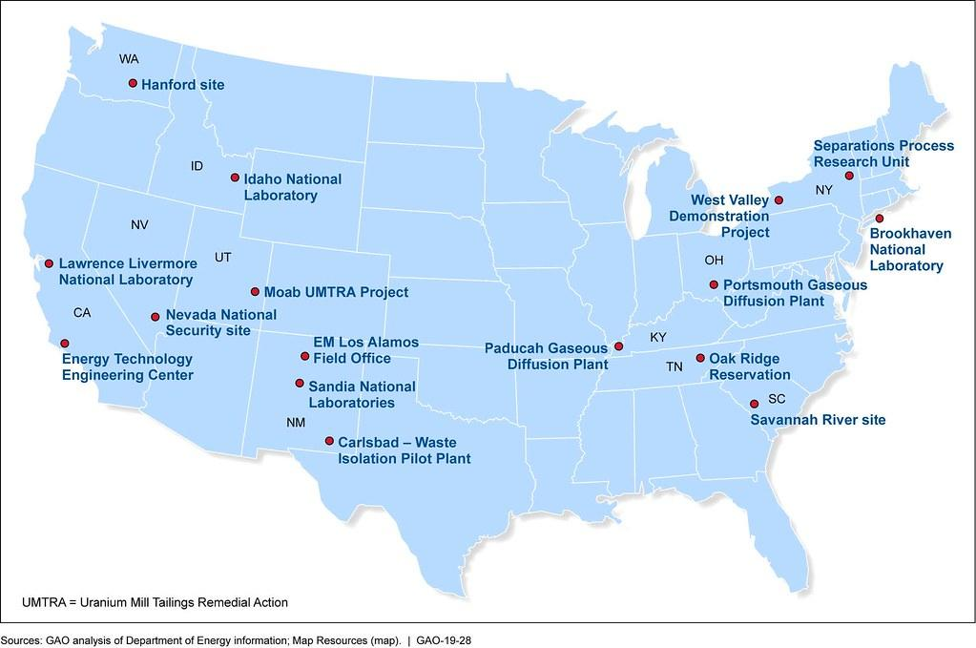
Location of Oak-Ridge Diffusion Plant

Slide 4
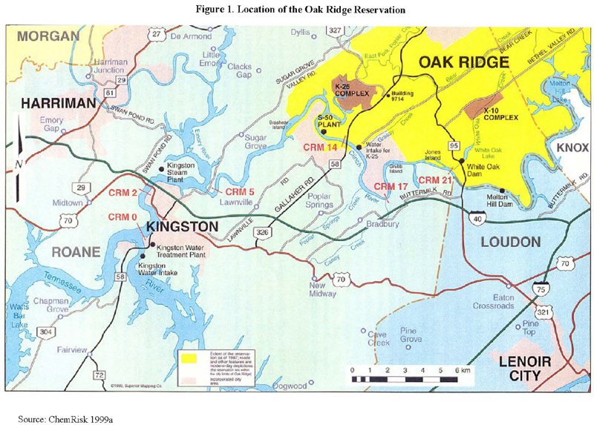
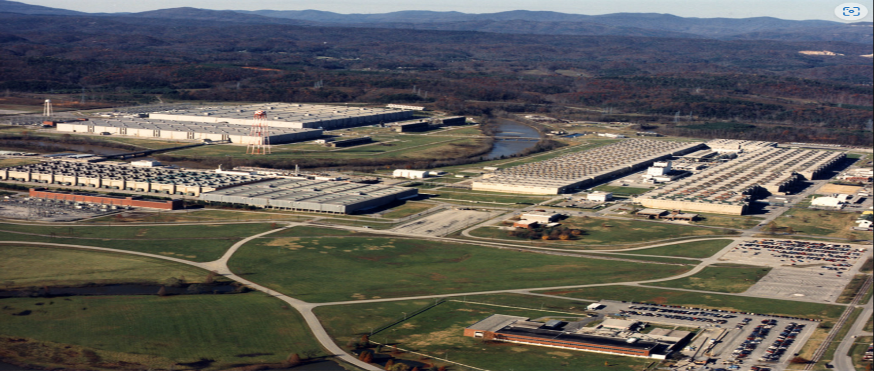
Oak- Ridge Gaseous Diffusion Plant (K-25)
Located in Tennessee, K-25 was the first gaseous diffusion plant, pivotal in the Manhattan project and operated from 1945- 1985

Slide 5
Site Transition
After closure, the Department of Energy (DOE) initiated a massive cleanup, soil remediation and repurposing effort.
The site has been transformed into the East Tennessee Technology Park (ETTP), a hub for economic and industrial development​.

Slide 6
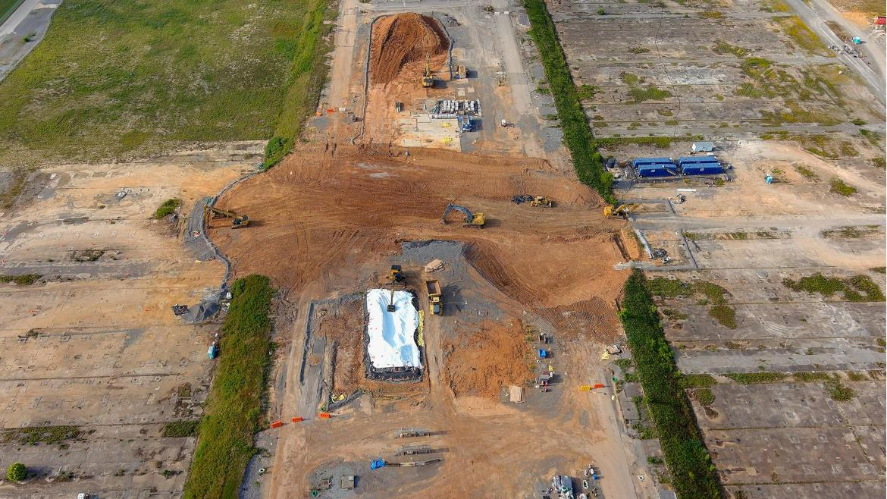
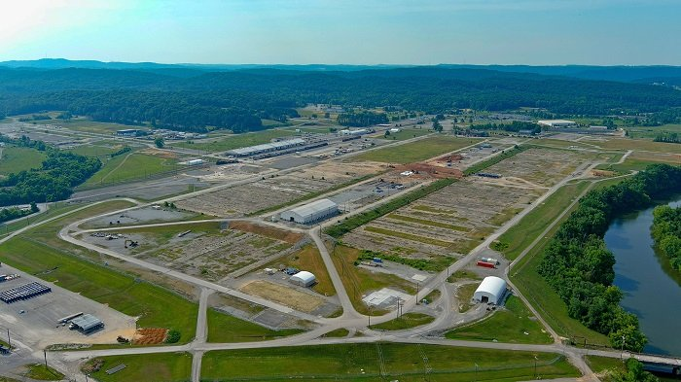
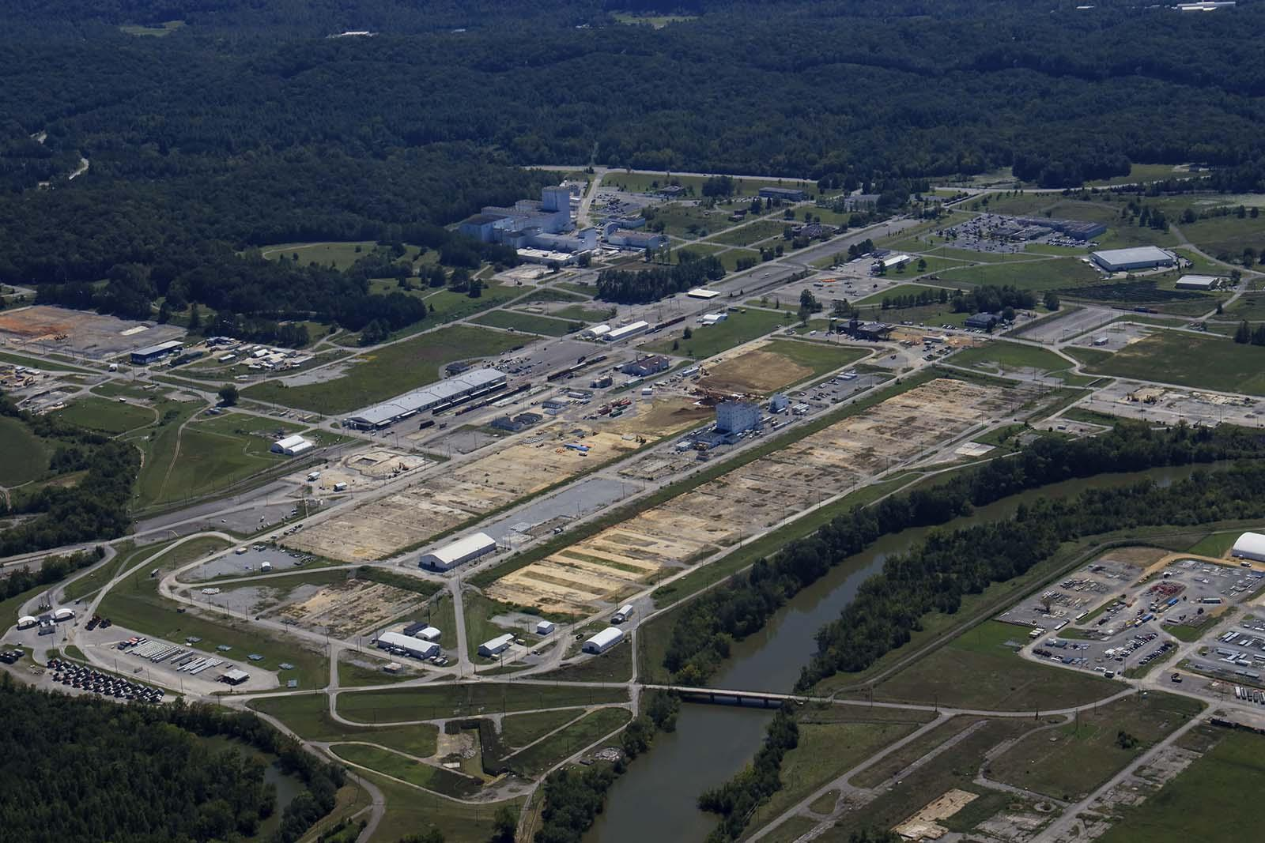
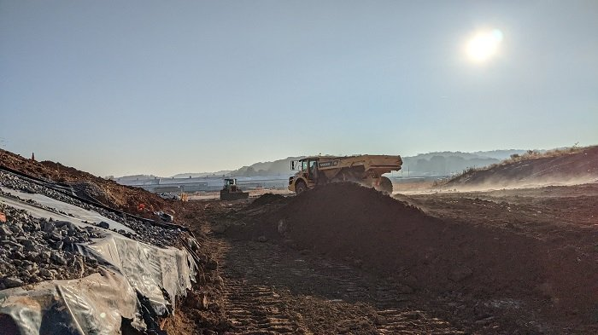
Soil Remediation

Slide 7
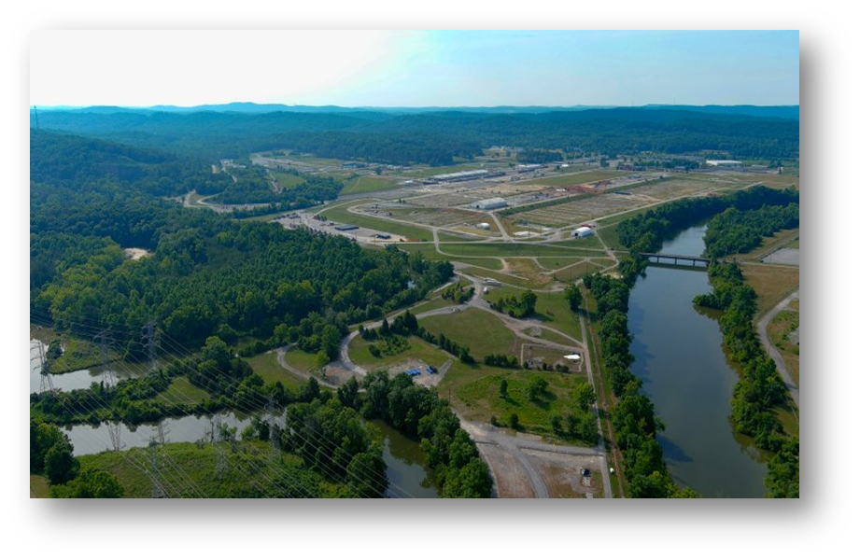
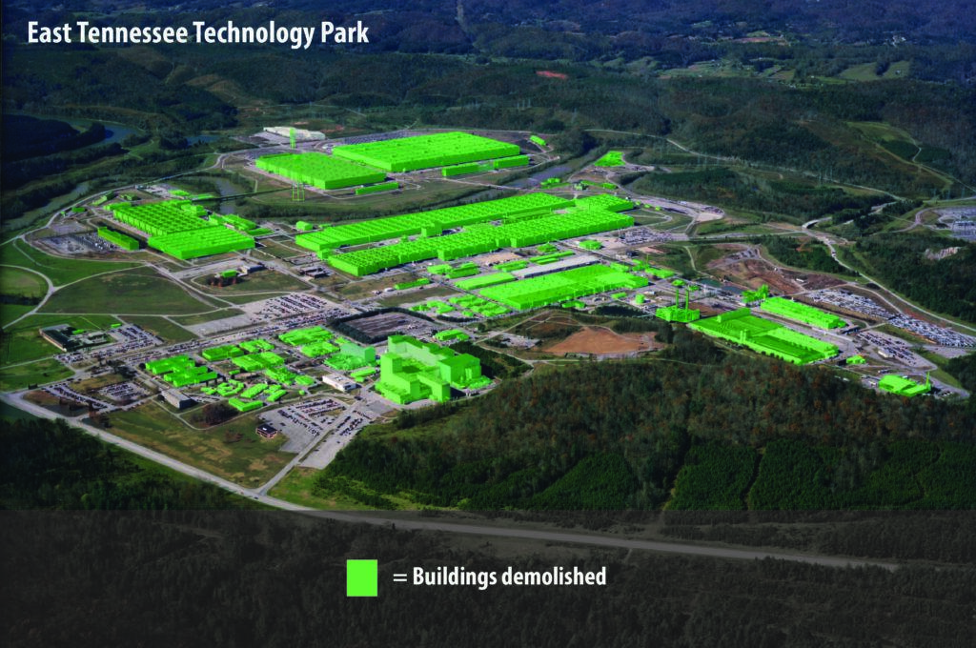
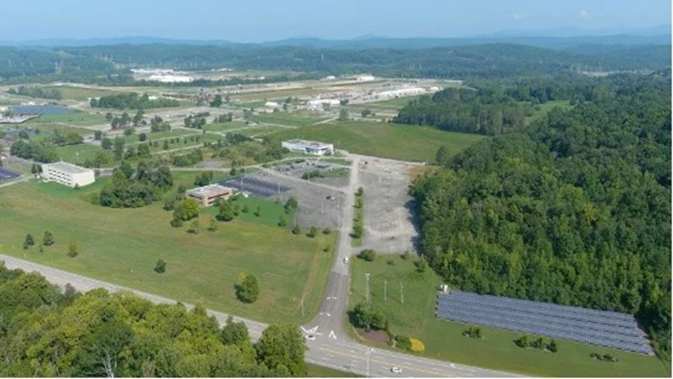
East Tennessee Technology Park
https://www.youtube.com/watch?app=desktop&v=k2fmrlc4nIE

Slide 8
Environmental Cleanup Achievements
Demolition of over 500 structures, including the five massive uranium enrichment buildings like the iconic K-25, was completed by 2020. ​Energy.gov.
Soil remediation efforts were also completed in 2024, removing over 554,000 cubic yards of contaminated soil. ​Nuclear Engineering International

Slide 9
Economic Development
More than 1,700 acres of land have been transferred for private development, leading to $1.35 billion in investments and the creation of around 1,400 jobs​Nuclear Engineering International Energy.gov
The site now hosts 25 businesses, transforming it into an economic asset​ GTTSi.

Slide 10
Historical Preservation
A new K-25 Viewing Platform is under construction, preserving the legacy of the Oak Ridge facility and its role in World War II and the Cold War.
The platform will provide educational displays about the site's history and uranium enrichment processes​Oak Ridge Today LRD USAE

Slide 11
Advanced Nuclear Projects
Kairos Power is constructing the Hermes reactor, a low-power demonstration reactor at the former K-33 site. This project is part of the DOE’s effort to support advanced nuclear technologies ​Kairos Power ​American Public Power Association.
The reactor, scheduled for completion by 2027, will showcase new reactor designs aimed at affordable clean energy production ​Kairos Power.

Slide 12
Future Plans
Ongoing groundwater remediation is set to continue through 2026 to ensure full environmental recovery​Nuclear Engineering International.
The DOE's long-term vision includes the final transfer of land for continued industrial use and the development of conservation and historical sites​American Nuclear Society ​Energy.gov

Slide 13
Conclusion
The Oak Ridge site has successfully transitioned from a major uranium enrichment facility to a center for innovation, economic development, and historical preservation.
It serves as a model for how former industrial sites can be remediated and repurposed for modern use ​Energy.gov Nuclear Engineering International​.

